Slide 1
COVID-19 and TCM: An Update on the FDA-Approved Clinical Studies
John K. Chen, Ph.D., Pharm.D., O.M.D., L.Ac.
Sponsored by Lhasa/OMS
Pacific Symposium 2021
Lotus Institute of Integrative Medicine, PO Box 92493, City of Industry, CA 91715
Shall not be copied, duplicated, or distributed in any format or be used for teaching without prior written consent from Lotus Institute of Integrative Medicine
Notes:
1
1

Slide 2
COVID-19 and TCM: An Update on the FDA-Approved Clinical Studies
Several major colleges and medical schools are conducting research on COVID-19 and TCM.
UCLA (University of California Los Angeles) and UCSD (University of California San Diego)
USC (University of Southern California)
SIEAM (Seattle Institute of East Asian Medicine)
Others
Disclaimer: This course only refers to the research aspect and currently there are no ‘proven’ treatments for COVID-19’.

Slide 3
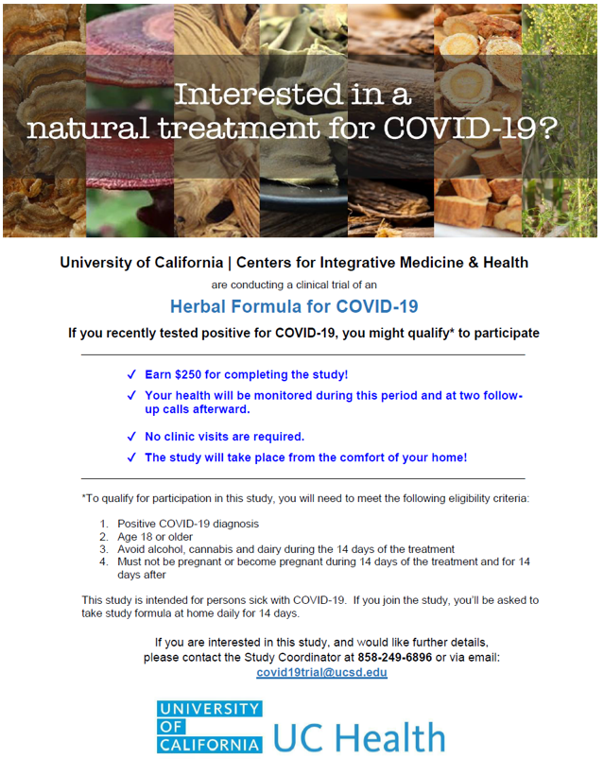

Slide 4
Multicenter Double Blind, Placebo Controlled RCT of Modified Qing Fei Pai Du Tang (mQFPD) for COVID-19

Slide 5
Brief Summary
This is a multi-center, randomized, double-blind, placebo-controlled clinical trial to evaluate a 21-herb formula named modified Qing Fei Pai Du Tang (mQFPD) to treat COVID-19-positive outpatients with mild-tomoderate symptoms assigned to self-quarantined and home management. This the study aims to establish the safety and feasibility of the use of mQFPD vs placebo in 66 total subjects. Subsequent trials will evaluate other therapeutics as well as the efficacy of mQFPD in a larger study population

Slide 6
Detailed Description
Study participants will be assigned to one of two groups, either placebo or mQFPD. Participants will be screened and consented remotely. Both groups will receive blood draws at days 1 and 14, and will be sent study medication directly to their home from the investigational pharmacy. Baseline and endof-study laboratory draws will be done at home via mobile phlebotomy. Adverse events and symptoms scores will be monitored by entry into a daily diary along with regular phone calls with the study coordinators. At the end of the study, safety will be assessed by laboratory measures and adverse event reporting

Slide 7
Study Design
https://clinicaltrials.ucbraid.org/trial/NCT04939415
https://clinicaltrials.gov/ct2/show/NCT04939415

Slide 8
Study Design
https://clinicaltrials.ucbraid.org/trial/NCT04939415
https://clinicaltrials.gov/ct2/show/NCT04939415

Slide 9
Guidance for Corona Virus Disease 2019
Chinese version
7th edition
8th edition
English version
英文版全文 _ 新型冠状病毒肺炎防控和诊疗指南 https://mp.weixin.qq.com/s/nOAmosQ4YqkXHKdJbBE9GA

Slide 10
Guidance for Corona Virus Disease 2019
Medical Observation Period: Type 1 and Type 2
Clinical Treatment Period (for confirmed cases)
General Type
Mild Type:
Cold dampness stagnating Lungs
Damp heat accumulated Lungs
Moderate Type:
Damp poison stagnating Lungs
Cold dampness obstructing Lungs
Severe Type:
Lung blocked by epidemic toxin
Flaring heat in Qi and Ying levels
Critical Type:
Internal block and outward desertion
Recovery Period:
Lung and Spleen qi deficiency
Deficiency of qi and yin
英文版全文 _ 新型冠状病毒肺炎防控和诊疗指南 https://mp.weixin.qq.com/s/nOAmosQ4YqkXHKdJbBE9GA

Slide 11
Guidance for Corona Virus Disease 2019
Medical Observation Period: Type 1 and Type 2
Clinical Treatment Period (for confirmed cases)
General Type = Qing Fei Pai Du Tang
Mild Type:
Cold dampness stagnating Lungs
Damp heat accumulated Lungs
Moderate Type:
Damp poison stagnating Lungs
Cold dampness obstructing Lungs
Severe Type:
Lung blocked by epidemic toxin
Flaring heat in Qi and Ying levels
Critical Type:
Internal block and outward desertion
Recovery Period:
Lung and Spleen qi deficiency
Deficiency of qi and yin
Xuan Fei Bai Du
英文版全文 _ 新型冠状病毒肺炎防控和诊疗指南 https://mp.weixin.qq.com/s/nOAmosQ4YqkXHKdJbBE9GA

Slide 12
清肺排毒汤 Qing Fei Pai Du Tang (Lung Cleansing & Detoxifying Decoction)
麻黃杏仁甘草石膏湯 Má Huáng Xìng Rén Gān Căo Shí Gāo Tāng (Ephedra, Apricot Kernel, Licorice, and Gypsum Decoction)
射干麻黃湯 Shè Gān Má Huáng Tāng (Belamcanda and Ephedra Decoction)
小柴胡湯 Xiăo Chái Hú Tāng (Minor Bupleurum Decoction)
五苓散 Wŭ Líng Săn (Five-Ingredient Powder with Poria)
https://www.elotus.org/content/tcm-resources-covid-19

Slide 13
清肺排毒汤 Qing Fei Pai Du Tang (Lung Cleansing & Detoxifying Decoction)
Ma Huang (Herba Ephedrae), 9g
Zhi Gan Cao (Radix et Rhizoma Glycyrrhizae Praeparata cum Melle), 6g
Ku Xing Ren (Semen Armeniacae Amarum), 9g
Shi Gao (Gypsum Fibrosum), 15-30g (pre-decoct)
Gui Zhi (Ramulus Cinnamomi), 9g
Ze Xie (Rhizoma Alismatis), 9g
Zhu Ling (Polyporus), 9g
Bai Zhu (Rhizoma Atractylodis Macrocephalae), 9g
Fu Ling (Poria), 15g
Chai Hu (Radix Bupleuri), 16g
Huang Qin (Radix Scutellariae), 6g
Jiang Ban Xia (Rhizoma Pinelliae Praeparatum cum Zingibere et Alumine), 9g
Sheng Jiang (Rhizoma Zingiberis Recens), 9g
Zi Wan (Radix et Rhizoma Asteris), 9g
Kuan Dong Hua (Flos Farfarae), 9g
She Gan (Rhizoma Belamcandae), 9g
Xi Xin (Radix et Rhizoma Asari), 6g
Shan Yao (Rhizoma Dioscoreae), 12g
Zhi Shi (Fructus Aurantii Immaturus), 6g
Chen Pi (Pericarpium Citri Reticulatae), 6g
Guang Huo Xiang (Herba Pogostemonis), 9g
https://www.elotus.org/content/tcm-resources-covid-19

Slide 14
清肺排毒汤 Qing Fei Pai Du Tang (Lung Cleansing & Detoxifying Decoction)
麻黃 Má Huáng (Herba Ephedrae) contains ephedrine alkaloids and the use may be restricted or prohibited. Substitution options include Xiang Ru (Herba Moslae), Di Long (Pheretima), Ku Xing Ren (Semen Armeniacae Amarum) and Zi Su Zi (Fructus Perillae).
款冬花 Kuăn Dōng Huā (Flos Farfarae) contains pyrrolizidine alkaloids and the use may be restricted or prohibited. Substitution options include Ku Xing Ren (Semen Armeniacae Amarum), Zi Wan (Radix et Rhizoma Asteris), Zi Su Zi (Fructus Perillae) or Pi Pa Ye (Folium Eriobotryae).
細辛 Xì Xīn (Radix et Rhizoma Asari) contains aristolochic acid and the use may be restricted or prohibited. Substitution options include Qiang Huo (Rhizoma et Radix Notopterygii), Fang Feng (Radix Saposhnikoviae), Gan Jiang (Rhizoma Zingiberis) or Jie Zi (Semen Sinapis).
https://www.elotus.org/content/tcm-resources-covid-19

Slide 15
Drug: mQFPD or Placebo
The dosage of mQFPD or placebo is 8 capsules three times a day for 14 consecutive days. It does not need to be consumed with food. It is best taken at least 30 minutes before OR at least 60 minutes after meals, in the morning, noon and evening. Accidentally missed doses will not need to be taken at a later time but will be recorded in a daily diary.
https://clinicaltrials.ucbraid.org/trial/NCT04939415
https://clinicaltrials.gov/ct2/show/NCT04939415

Slide 16
mQFPD
Thomas Leung, DACM/Kamwo Herbs

Slide 17
Primary Outcome Measures
Incidence of Treatment-Emergent Adverse Events [Safety and Tolerability] [Time Frame: 2 months] Quantitative monitoring of SARS-CoV-2 shedding in order to detect early potential increases in SARS-CoV-2 viral load during treatment. The safety of the study medication will also be assessed through laboratory data collection at baseline, and at either the end of the treatments
Feasibility of the intervention [Time Frame: 2 months] With the primary outcomes focusing on determination of the rates of recruitment and completion
https://clinicaltrials.ucbraid.org/trial/NCT04939415
https://clinicaltrials.gov/ct2/show/NCT04939415

Slide 18
Secondary Outcome Measures:
Duration of viral illness
Hospitalization rate
ICU admission rate
Ventilatory requirement
Lymphocyte count
Neutrophil count
7. Ferritin
8. D-dimer
9. Lactate dehydrogenase
10. C-reactive protein
11. Troponin
12. Mid-turbinate SARS CoV-2 viral load
https://clinicaltrials.ucbraid.org/trial/NCT04939415
https://clinicaltrials.gov/ct2/show/NCT04939415

Slide 19
Other
Inclusion Criteria
Exclusion Criteria
https://clinicaltrials.ucbraid.org/trial/NCT04939415
https://clinicaltrials.gov/ct2/show/NCT04939415

Slide 20
More Information
Responsible Party: Gordon Saxe M.D., Director, Krupp Center for Integrative Research, University of California, San Diego
ClinicalTrials.gov Identifier: NCT04939415 History of Changes
Other Study ID Numbers: 200633-1b
https://clinicaltrials.ucbraid.org/trial/NCT04939415
https://clinicaltrials.gov/ct2/show/NCT04939415

Slide 21
Indepth Webinars
https://www.elotus.org/free-course/clinical-study-ucla-ucsd
https://www.pacificcollege.edu/news/blog/2021/09/15/groundbreaking-fda-approved-study-mushrooms-and-chinese-herbs-for-covid-19

Slide 22
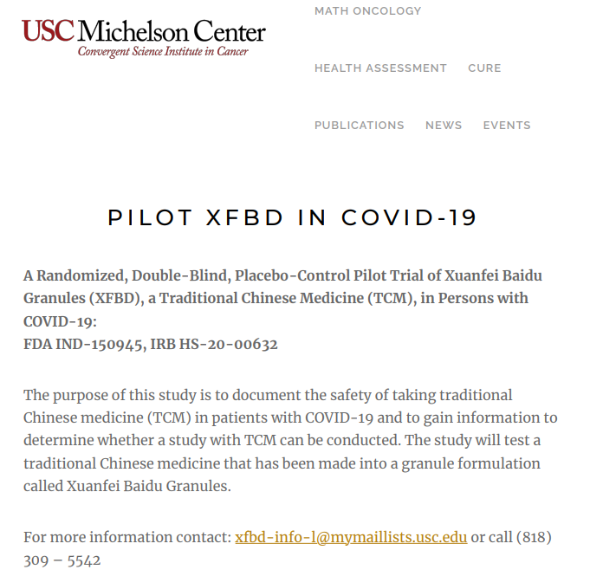

Slide 23
A Randomized, Double-Blind, Placebo-Control Pilot Trial of Xuanfei Baidu Granules (XFBD), a Traditional Chinese Medicine (TCM), in Persons With COVID-19

Slide 24
Brief Summary
The purpose of this study is to document the safety of taking traditional Chinese medicine (TCM) in patients with COVID-19 and to gain information to determine whether a study with TCM can be conducted. The study will test a traditional Chinese medicine that has been made into a granule formulation called Xuanfei Baidu Granules.
https://clinicaltrials.gov/ct2/show/NCT04810689

Slide 25
Detailed Description
Xuanfei Baidu granules (XFBD) is a 13 medicinal traditional Chinese medicine (TCM) prescription developed by Dr. Zhang Boli, a member of Chinese Academy of Engineering, and his team, and used in Wuhan, China, during the initial outbreak of SARS-CoV2. Based on TCM theory, the 13 medicinals used mainly consist of heat-clearing and toxin-removing medicinals to reduce fever and clear viruses; cough-suppressing and phlegm-transforming medicinals to thin and clear the phlegm; and lung-diffusing and pant-calming to soothe the tracheal smooth muscle and relieve shortness of breath. Another unique quality is one of the medicinals helps to dissipate stasis and dissolves blood clots, providing a mild anticoagulant effect.
https://clinicaltrials.gov/ct2/show/NCT04810689

Slide 26
Detailed Description
Before the widespread usage of TCM, nationwide China saw a progression of disease of about 10% of their mild and moderate cases while during the period with the TCM utilization, the percentage dropped to 2-5% depending on the hospital. Overall, they saw an improvement of clinical symptoms. Due to the challenges of the rapidly evolving outbreak, these are clinical observations and not evidence from a controlled study.
https://clinicaltrials.gov/ct2/show/NCT04810689

Slide 27
Detailed Description
The purpose of this initial pilot study is to document the safety of taking a TCM in patients with COVID-19 and to gain information to determine whether a study with TCM can be conducted in the US. The study will test a TCM which has been made into a granule formulation called XFBD.
https://clinicaltrials.gov/ct2/show/NCT04810689

Slide 28
Detailed Description
This is a randomized double-blind placebo-control pilot trial to document safety and efficacy endpoint assessments and to determine the feasibility of community recruitment and enrollment of symptomatic adult outpatients with COVID-19. The 12-week pilot will have 14 days where they receive XFBD or a placebo, orally twice a day and a 10 week follow up. The study will have a total of 60 participants with approximately 30 participants in each treatment arm. The participants will be randomized 1:1 individuals.
https://clinicaltrials.gov/ct2/show/NCT04810689

Slide 29
Study Design
https://clinicaltrials.gov/ct2/show/NCT04810689

Slide 30
Study Design
https://clinicaltrials.gov/ct2/show/NCT04810689

Slide 31
Guidance for Corona Virus Disease 2019
Chinese version
7th edition
8th edition
English version
英文版全文 _ 新型冠状病毒肺炎防控和诊疗指南 https://mp.weixin.qq.com/s/nOAmosQ4YqkXHKdJbBE9GA

Slide 32
Guidance for Corona Virus Disease 2019
Medical Observation Period: Type 1 and Type 2
Clinical Treatment Period (for confirmed cases)
General Type = Qing Fei Pai Du Tang
Mild Type:
Cold dampness stagnating Lungs
Damp heat accumulated Lungs
Moderate Type:
Damp poison stagnating Lungs
Cold dampness obstructing Lungs
Severe Type:
Lung blocked by epidemic toxin
Flaring heat in Qi and Ying levels
Critical Type:
Internal block and outward desertion
Recovery Period:
Lung and Spleen qi deficiency
Deficiency of qi and yin
Xuan Feai Du
英文版全文 _ 新型冠状病毒肺炎防控和诊疗指南 https://mp.weixin.qq.com/s/nOAmosQ4YqkXHKdJbBE9GA

Slide 33
Guidance for Corona Virus Disease 2019
Medical Observation Period: Type 1 and Type 2
Clinical Treatment Period (for confirmed cases)
General Type
Mild Type:
Cold dampness stagnating Lungs
Damp heat accumulated Lungs
Moderate Type:
Damp poison stagnating Lungs = Xuan Fei Bai Du Fang
Cold dampness obstructing Lungs
Severe Type:
Lung blocked by epidemic toxin
Flaring heat in Qi and Ying levels
Critical Type:
Internal block and outward desertion
Recovery Period:
Lung and Spleen qi deficiency
Deficiency of qi and yin
Xuan Fei Bai Du
英文版全文 _ 新型冠状病毒肺炎防控和诊疗指南 https://mp.weixin.qq.com/s/nOAmosQ4YqkXHKdJbBE9GA

Slide 34
Guidance for Corona Virus Disease 2019
Medical Observation Period: Type 1 and Type 2
Clinical Treatment Period (for confirmed cases)
General Type = Qing Fei Pai Du Tang
Mild Type:
Cold dampness stagnating Lungs
Damp heat accumulated Lungs
Moderate Type:
Damp poison stagnating Lungs = Xuan Fei Bai Du Fang
Cold dampness obstructing Lungs
Severe Type:
Lung blocked by epidemic toxin
Flaring heat in Qi and Ying levels
Critical Type:
Internal block and outward desertion
Recovery Period:
Lung and Spleen qi deficiency
Deficiency of qi and yin
Xuan Fei Bai Du
Xuan Fei Bai Du
英文版全文 _ 新型冠状病毒肺炎防控和诊疗指南 https://mp.weixin.qq.com/s/nOAmosQ4YqkXHKdJbBE9GA

Slide 35
宣肺败毒方 Xuan Fei Bai Du Fang (Lung Ventilating and Detoxifying Formula)
Ma Huang (Herba Ephedrae) 6g
Ku Xing Ren (Semen Armeniacae Amarum) 15g
Shi Gao (Gypsum Fibrosum) 30g
Yi Yi Ren (Semen Coicis) 30g
Cang Zhu (Rhizoma Atractylodis) 10g
Guang Huo Xiang (Herba Pogostemonis) 15g
Qing Hao (Herba Artemisiae Annuae) 12g
Hu Zhang (Rhizoma et Radix Polygoni Cuspidati) 20g
Ma Bian Cao (Herba Verbenae) 30g
Lu Gen (Rhizoma Phragmitis) 30g
Ting Li Zi (Semen Lepidii) 15g
Ju Hong (Exocarpium Citri Rubrum) 15g
Gan Cao (Radix et Rhizoma Glycyrrhizae) 10g
https://www.elotus.org/content/tcm-resources-covid-19

Slide 36
宣肺败毒方 Xuan Fei Bai Du Fang (Lung Ventilating and Detoxifying Formula)
麻黃 Má Huáng (Herba Ephedrae) contains ephedrine alkaloids and the use may be restricted or prohibited. Substitution options include Xiang Ru (Herba Moslae), Di Long (Pheretima), Ku Xing Ren (Semen Armeniacae Amarum) and Zi Su Zi (Fructus Perillae).
https://www.elotus.org/content/tcm-resources-covid-19

Slide 37
Drug: Xuanfei Baidu Granules
XFBD (administered as 1 packet of granules dissolved in warm water) orally twice daily for 14 day, 1 hour after food in the morning and at night with at least 8 hours in between doses
https://clinicaltrials.gov/ct2/show/NCT04810689

Slide 38
Placebo Comparator
Placebo (administered as 1 packet of granules dissolved in warm water) orally twice daily for 14 day, 1 hour after food in the morning and at night with at least 8 hours in between doses
https://clinicaltrials.gov/ct2/show/NCT04810689

Slide 39
Primary Outcome Measures
Feasibility of recruitment
Participation Rate
Side Effects and Safety Profile
Rate of hospitalization or death
https://clinicaltrials.gov/ct2/show/NCT04810689

Slide 40
Secondary Outcome Measures
Symptom Severity Score
Study agent compliance
Symptom monitoring compliance
COVID-19 testing compliance
Hospital-free days
Adverse Events
Grade 3 and 4 adverse events
Viral load
https://clinicaltrials.gov/ct2/show/NCT04810689

Slide 41
Other
Inclusion Criteria
Exclusion Criteria
https://clinicaltrials.gov/ct2/show/NCT04810689

Slide 42
More Information
Responsible Party: Darcy Spicer M.D., Associate Professor, University of Southern California
ClinicalTrials.gov Identifier: NCT04810689
Other Study ID Numbers: HS-20-00632

Slide 44
Brief Summary
The purpose of the study is to design and execute a prospective, longitudinal, descriptive cohort study in a pragmatic clinical practice for adults with symptoms that may be related to COVID-19.
https://clinicaltrials.gov/ct2/show/NCT04380870

Slide 45
Detailed Description
The purpose of this study is to design and execute a prospective, longitudinal, descriptive cohort study in a pragmatic clinical practice for adults with symptoms that may be related to COVID-19 infection who participate in Chinese herbal medicine (CHM) telehealth visits and take CHM. CHM includes over 400 medicinal substances and CHM formulas are individualized at each visit according to the patient's presentation. CHM has been used to treat cough, shortness of breath, and fatigue and mechanisms of action have been investigated for SARS and H1N1 influenza prevention and treatment by anti-inflammatory effects and antiviral activity. Yet, there is a gap in our understanding of the clinical application of CHM in a community sample of individuals experiencing symptoms that may be related to COVID-19. The investigators have no pragmatic clinic data about the use of CHM for coronaviruses.
https://clinicaltrials.gov/ct2/show/NCT04380870

Slide 46
Detailed Description
Safe and effective treatment of symptoms associated with COVID-19 is a top international priority and research is needed to better understand if CHM is a safe intervention to treat symptoms. Further, dissemination of trustworthy CHM treatment approaches for this complex and emergent condition is needed within the CHM and scientific communities.
https://clinicaltrials.gov/ct2/show/NCT04380870

Slide 47
Study Design
https://clinicaltrials.gov/ct2/show/NCT04380870

Slide 48
Study Design
Individualized CHM dispensed either as raw herbs to be decocted at home or granule
Follow up at 24- and 48-hours after each telehealth visit.
Additional follow up at 3, 6 and 12 months.
https://clinicaltrials.gov/ct2/show/NCT04380870
KIOM-SAR 2020 International Research Conference Abstracts / Integrative Medicine Research 9 (2020) 100498

Slide 49
More Information
Responsible Party: Katherine Taromina, DACM, Instructor, Supervisor, Center for Integrated Care
ClinicalTrials.gov Identifier: NCT04380870
Other Study ID Numbers: 01-04-20
https://clinicaltrials.gov/ct2/show/NCT04380870

Slide 50
Other
Medical Herbs Inhibit Inflammation Directing T Cells to Kill the COVID-19 Virus (NCT04790240)
Assessment of Efficacy of KAN-JANG® in Mild COVID-19 (NCT04847518)
Efficacy and Safety of High-dose Vitamin C Combined With Chinese Medicine Against Coronavirus Pneumonia (COVID-19) (NCT04664010)
https://clinicaltrials.gov/

Slide 51
The Process of Drug Development
https://www.lanl.gov/museum/news/newsletter/2018/03/drug-approval.php

Slide 52
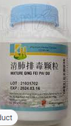
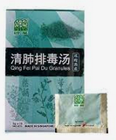
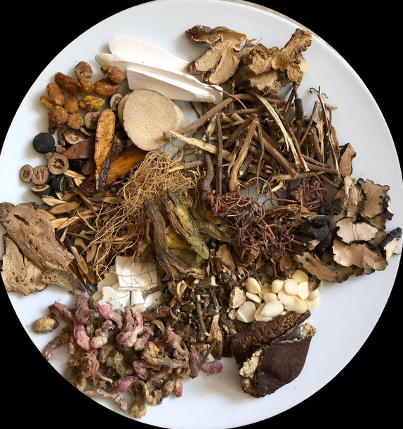
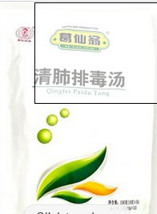
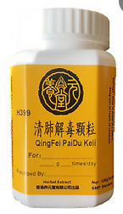
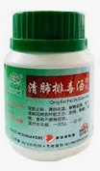
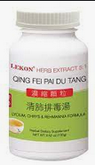

Slide 53
COVID-19 and TCM: An Update on the FDA-Approved Clinical Studies
John K. Chen, Ph.D., Pharm.D., O.M.D., L.Ac.
John.chen@evherbs.com
626-810-5530
Sponsored by Lhasa/OMS
Pacific Symposium 2021
Lotus Institute of Integrative Medicine, PO Box 92493, City of Industry, CA 91715
Shall not be copied, duplicated, or distributed in any format or be used for teaching without prior written consent from Lotus Institute of Integrative Medicine
Notes:
53
53

