Slide 1
Coronavirus (Covid-19)
Treatment with TCM in China
John K. Chen, Ph.D., Pharm.D., O.M.D., L.Ac.
Lori Hsu, MTOM, MS
Michael Norris, L.Ac., C.H.
Debra Nash-Galpern, L.Ac.
Robert Chu, OME
Lorraine Wilcox, L.Ac.
Donna Chow, L.Ac., DiplOM
Special thanks to Drs. Chen Juan, Huang Di, Wang Shi Qi, Cai Xiang, Tang Ying and several other doctors who wish to remain “anonymous.”
Lotus Institute of Integrative Medicine, PO Box 92493, City of Industry, CA 91715
Shall not be copied, duplicated, or distributed in any format or be used for teaching without prior written consent from Lotus Institute of Integrative Medicine
Notes:
1
1

Slide 2

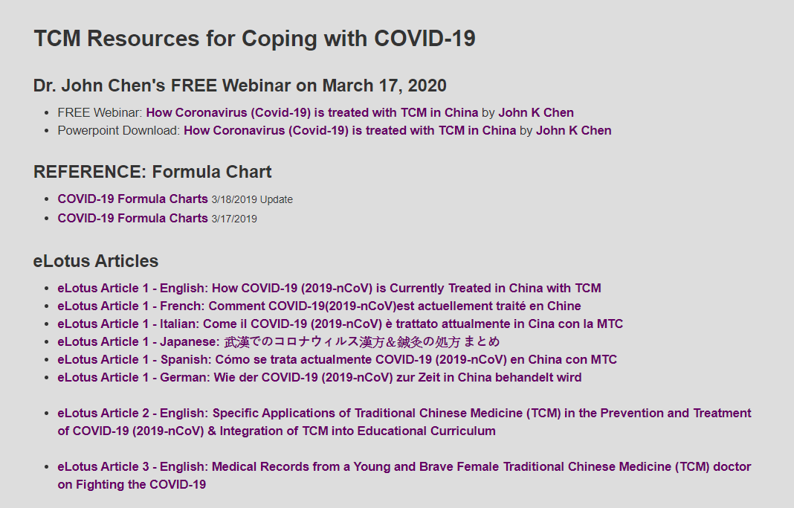
https://www.elotus.org/content/tcm-resources-covid-19

Slide 3
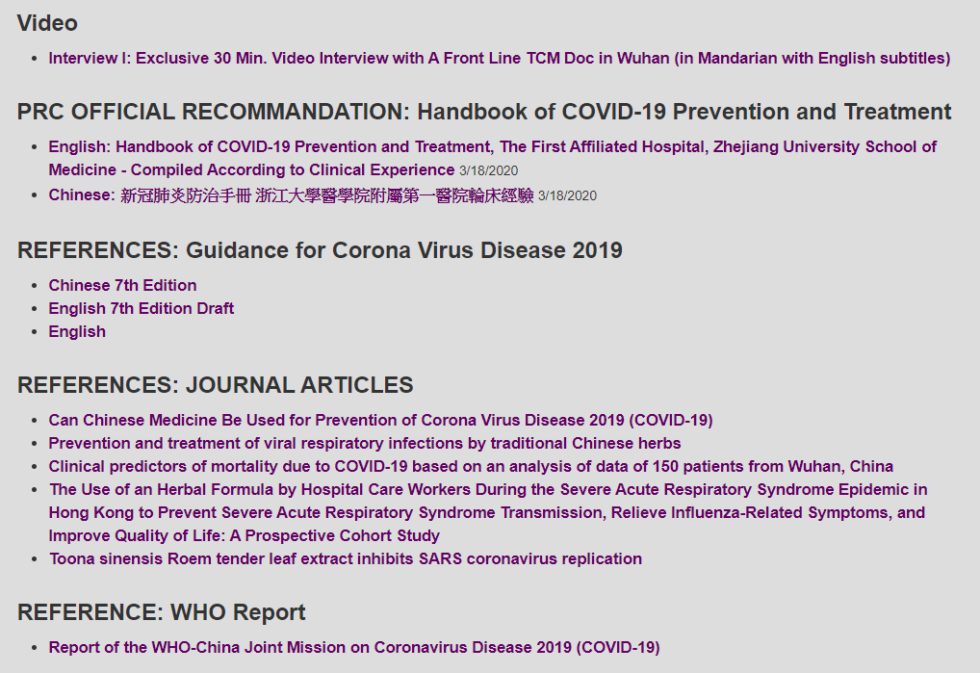
https://www.elotus.org/content/tcm-resources-covid-19

Slide 4
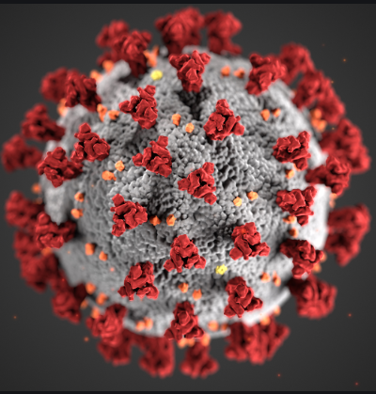
Biology
Coronavirus is an RNA virus
SARS-CoV causes SARS.
SARS-CoV-2 causes Covid-19.
96% genome identity
Report of the WHO-China Joint Mission on Coronavirus Disease (COVID-19) 16-24 February 2020.
https://emcrit.org/ibcc/covid19/?fbclid=IwAR31Xy-vkhL39xSWNAqkx3fECRR2yQLVbyWD2EOOoDG7FYv2WXqdQm7Lu_U#biology

Slide 5
Clinical Manifestation
Incubation: 2-14 days
Resp s/sx: fever, dry cough, sneezing, runny nose, sputum production, nasal congestion, shortness of breath, lethargy, muscle pain, headache and dehydration.
GI s/sx: 5-10% of patients can present initially with diarrhea or nausea, before fever and dyspnea
Wang, et al. Clinical Characteristics of 138 Hospitalized Patients With 2019 Novel Coronavirus–Infected Pneumonia in Wuhan, China. JAMA. Published online February 7, 2020. doi:10.1001/jama.2020.1585

Slide 6
Pathophysiology
Cytokine storm: The coronavirus causes uncontrolled / dysfunctional immune response, leading to an overproduction of immune cells and their signaling molecules, resulting in a cytokine storm with a flood of immune cells into the lung.
S/Sx include: severe inflammatory disease, shortness of breath, inflammation of the airway, and finally acute respiratory distress syndrome and multiple organ failure.
https://www.the-scientist.com/news-opinion/why-some-covid-19-cases-are-worse-than-others-67160

Slide 7
Pathophysiology
In addition to hyper-inflammatory injury, the lung suffers physical injuries (diffuse alveolar damage, including hyaline membranes) and physiological compromises (wheezing, shortness of breath, etc).
Xu Z, et al. Pathological findings of COVID-19 associated with acute respiratory distress syndrome. https://www.thelancet.com/action/showPdf?pii=S2213-2600%2820%2930076-X

Slide 8
Biopsy
“Edema, proteinaceous exudate, focal reactive hyperplasia of pneumocytes with patchy inflammatory cellular infiltration, and multinucleated giant cells. Fibroblastic plugs were noted in airspaces.”
Xiao, Shu-Yuan. Pulmonary Pathology of Early COVID-19 Pneumonia Identified Retrospectively in Two Patients With Lung Cancer, The ASCO Post. 3/12/2020. https://ascopost.com/news/march-2020/pulmonary-pathology-of-early-covid-19-pneumonia-identified-retrospectively-in-two-patients-with-lung-cancer/

Slide 9
WM Diagnosis
Signs and symptoms evaluation
Nasopharyngeal swab
Chest x-ray and CT scan

Slide 10
WM Diagnosis
Lymphopenia is common, seen in ~80% of patients.
Mild thrombocytopenia is common (but platelets are rarely <100).
Lower platelet count is a poor prognostic sign.
Guan W et al. Clinical Characteristics of Coronavirus Disease 2019 in China. The New England Journal of Medicine. February 28, 2020.
Ruan Q et al. Clinical predictors of mortality due to COVID-19 based on an analysis of data of 150 patients from Wuhan, China. Intensive Care Med https://doi.org/10.1007/s00134-020-05991-x

Slide 11
WM Treatment
Acetaminophen, aspirin, ibuprofen
Antiviral: remdesivir, lopinavir, ritonavir.
Chloroquine
Steroids
Immunosuppressant
Ventilator
ECMO
Notes:
Remdesivir – for MERS. Still in clinical trial
lopinavir, ritonavir – for HIV. Slows replication of virus
Chloroquine – blocks receptor for virus landing. Has immunosuppressive effect
Steroids – lowers inflammation, but may increase viral shedding.

Slide 12
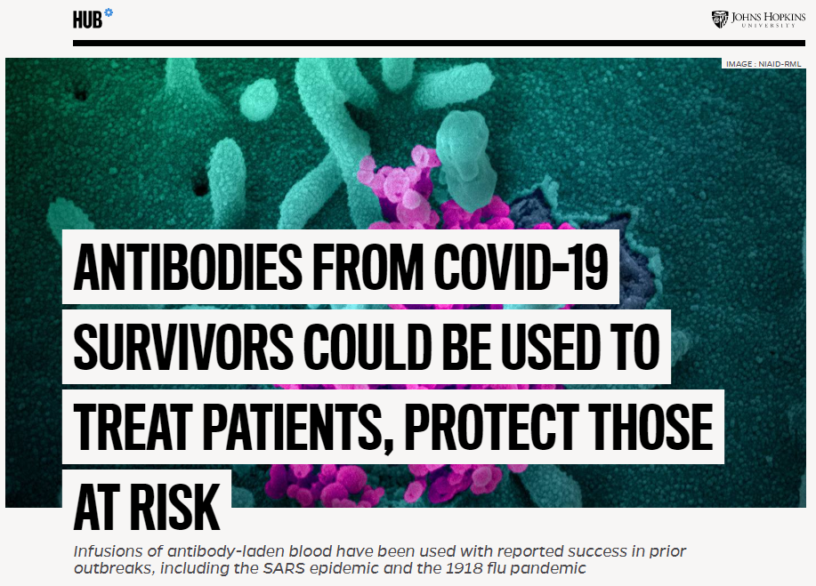
WM Treatment
Convalescent plasma
Convalescent sera
Johns Hopkins University.
https://hub.jhu.edu/2020/03/13/covid-19-antibody-sera-arturo-casadevall/

Slide 13
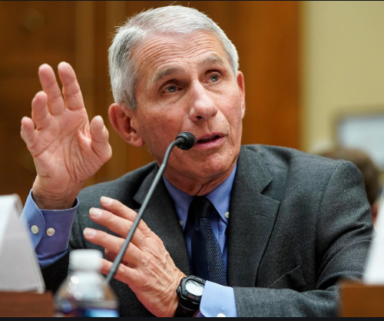
WM Treatment
“Vaccine for Covid-19 won’t be deployed for at least 1 to 1.5 years.”
  March 3, 2020
Anthony S. Fauci, M.D.,
Director of NAID (National Institute of Allergy and Infectious Diseases)

Slide 14
Prognosis
Up to 70% of people get Covid-19.
Most patients have mild illness. They don’t require medical attention and aren't counted.
The vast majority of infected patients (e.g. >80%) don't get significantly ill and don't require hospitalization.
Individuals under 18 years of age make up only 2.4% of all reported cases.
Individuals over 60 years of age, with pre-existing health conditions, have the highest risks.
Report of the WHO-China Joint Mission on Coronavirus Disease (COVID-19) 16-24 February 2020.
https://www.businessinsider.com/coronavirus-covid-19-angela-merkel-bundestag-infection-19-2020-3

Slide 15
Prognosis
Among hospitalized patients: ~10-20% of patients are admitted to ICU.
~3-10% require intubation.
~2-5% die.
Guan et al. Clinical Characteristics of Coronavirus Disease 2019 in China. The New England Journal of Medicine. https://www.nejm.org/doi/pdf/10.1056/NEJMoa2002032?articleTools=true

Slide 16
Prognosis
Patients who survive the initial phases of the illness may still require prolonged ventilator support (due to pulmonary fibrosis).
As the epidemic progresses, an issue which may arise is a large volume of patients unable to wean from mechanical ventilation.
Zhang, W. Imaging changes of severe COVID-19 pneumonia in advanced stage. Intensive Care Med (2020). https://doi.org/10.1007/s00134-020-05990-y

Slide 17
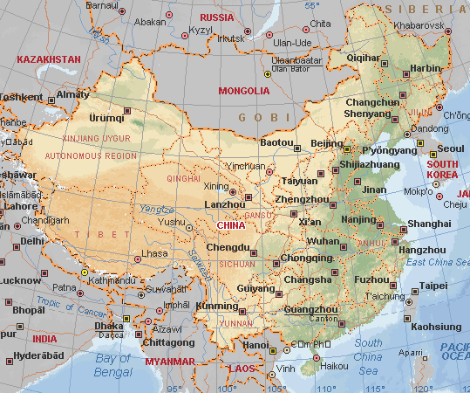
TCM and Epidemic Diseases
There have been over 320 large-scale epidemics in China between Eastern Han and Qing Dynasty (approximately 2,000 years).

Slide 18
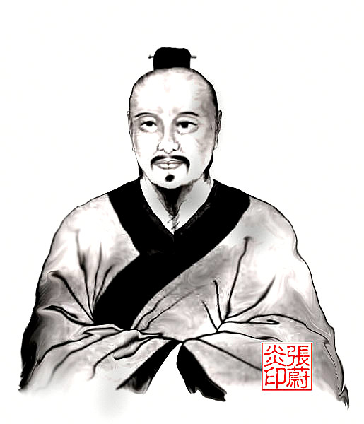
张仲景 Zhāng Zhòng-Jĭng, 150-219 CE
Shang Han 伤寒
(Cold-Induced Disorders)
  Taiyang
  Yangming
  Shaoyang
  Taiyin
  Shaoyin
  Jueyin

Slide 19
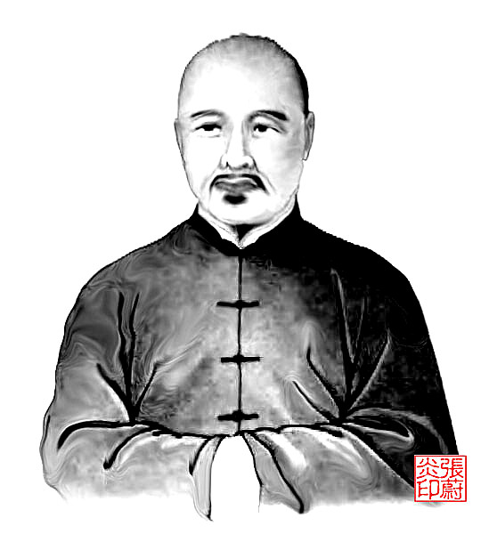
叶桂 Yè Guì, 1666-1745
Wen Bing 温病
(Warm Disease):
  wei (defensive) level
  qi (energy) level
  ying (nutritive) level
  xue (blood) level

Slide 20
TCM Pattern Differentiation
Taiyang
Yangming
Shaoyang
Taiyin
Shaoyin
Jueyin
Wei (defensive) level
Qi (energy) level
Ying (nutritive) level
Xue (blood) level

Slide 21
TCM Diagnosis
Early S/Sx: Fever, dry cough, sneezing, runny nose, nasal congestion, shortness of breath, lethargy, muscle pain, headache and dehydration.
Taiyang
  Wind-heat
  Wind-cold
  Wei (defensive) level

Slide 22
TCM Diagnosis
Lymphopenia is common, seen in ~80% of patients.
Mild thrombocytopenia is common.
Qi deficiency
Blood deficiency
Guan W et al. Clinical Characteristics of Coronavirus Disease 2019 in China. The New England Journal of Medicine. February 28, 2020.
Ruan Q et al. Clinical predictors of mortality due to COVID-19 based on an analysis of data of 150 patients from Wuhan, China. Intensive Care Med https://doi.org/10.1007/s00134-020-05991-x

Slide 23
TCM Diagnosis
S/Sx: severe inflammatory disease, shortness of breath, inflammation of the airway
Yangming
  Qi (energy) level

Slide 24
TCM Diagnosis
“Edema, proteinaceous exudate, focal reactive hyperplasia of pneumocytes with patchy inflammatory cellular infiltration, and multinucleated giant cells. Fibroblastic plugs were noted in airspaces.”
Damp and phlegm in the Lung
  Lung heat, with
  Lung cold, with

Slide 25
TCM Diagnosis
S/Sx: cytokine storm leading to acute respiratory distress syndrome and multiple organ failure.
Shaoyang
Taiyin
Shaoyin
Jueyin
Ying (nutritive) level
Xue (blood) level

Slide 26
TCM Diagnosis
In addition to hyper-inflammatory injury, the lung suffers physical injuries (diffuse alveolar damage, including hyaline membranes) and physiological compromises (wheezing, shortness of breath, etc).
Lung yin deficiency
Lung qi deficiency

Slide 27
TCM Diagnosis
Patients who survive the initial phases of the illness may still require prolonged ventilator support (due to pulmonary fibrosis).
Lung yin deficiency
Lung qi deficiency

Slide 28
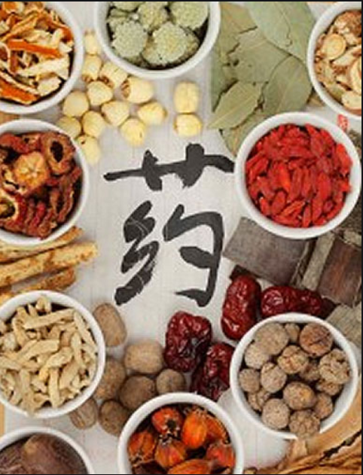
TCM and Covid-19
More than 85% of all patients with coronavirus, approximately 60,000 people, received herbal treatment along with western medicine treatments, as of late February 2020.
Ministry of Science and Technology, China.

Slide 29

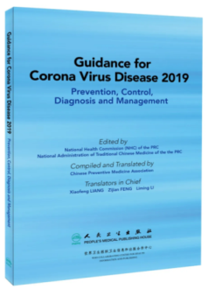

Hubei Provincial Hospital | Wuhan Union Hospital | Guidance for Covid-19
Prevention Phase | Prevention
Early Phase | Wind-Heat Invading the Exterior Syndrome | Medical Observation Period
Pneumonia Phase | Damp Warmth in Early Phase Damp Heat Obstructing the Lung Syndrome Epidemic Toxins Blocking the Lung Closed Interior and Abandoned Exterior | Clinical Treatment Period
Recovery Phase | Insufficiency of qi and yin, Deficiency of Lung and Spleen. | Recovery Period

Slide 30
Hubei Provincial Hospital of TCM
  Prevention Phase: 预防期
  Early Phase: 流感期
  Pneumonia Phase: 肺炎期
  Recovery Phase: 恢复期
湖北省中医院新型冠状病毒感染的肺炎中医药防治协定方（第一版）

Slide 31
Prevention Phase: 预防期
Early Phase: 流感期
  Wind-Cold Invading the Exterior 风寒袭表证
  Toxic Heat Attacking the Lung 热毒袭肺证
  Damp Cold in the Lung 濕寒鬱肺
Pneumonia Phase: 肺炎期
  Shaoyang Syndrome with Damp 少阳夹湿证
  Damp Heat Afflicting the Lung 湿热郁肺证
  Toxic Stagnation Obstructing the Lung 毒瘀壅肺证
  Closed Interior and Abandoned Exterior Syndrome 内闭外脱证
Recovery Phase: 恢复期
湖北省中医院新型冠状病毒感染的肺炎中医药防治协定方（第一版）

Slide 32
Prevention Phase: 预防期
Huang Qi 黄芪 (Radix Astragali) 15g
Bai Zhu 炒白术 (Rhizoma Atractylodis Macrocephalae), dry fried 10g
Fang Feng 防风 (Radix Saposhnikoviae) 10g
Mian Ma Guan Zhong 绵马贯众 (Rhizoma Dryopteridis Crassirhizomatis) 10g
Jin Yin Hua 金银花 (Flos Lonicerae Japonicae) 10g
Chen Pi 陈皮 (Pericarpium Citri Reticulatae) 6g
Pei Lan 佩兰 (Herba Eupatorii) 10g

Slide 33
Prevention Phase: 预防期
Bilateral Zusanli (ST 36), Qihai (CV 6), Zhongwan (CV 12)
  Moxa Zusanli (ST 36) on both sides for 15 minutes. Moxa Qihai (CV 6) or Zhongwan (CV 12) for 10 minutes. (alternating from treatment to treatment).
  Twice a day, once in the afternoon and once at night.

Slide 34
Early Phase: 流感期
Wind-Cold Invading Exterior 风寒袭表证
Toxic Heat Attacking the Lung 热毒袭肺证
Damp Cold in the Lung 濕寒鬱肺

Slide 35
Early Phase:
- Wind-Cold Invading the Exterior
S/Sx: Onset of fever (mostly low-grade fever), aversion to cold, chills, headache, ticklish throat, soreness of muscles of limbs, no sweat or night sweats.
Exam: Lung CT negative. Tongue is pale, coating is white and thin. Floating pulse
Treatment: Expel Wind, Release the Exterior; Clear Heat, Detoxify

Slide 36
Early Phase:
- Wind-Cold Invading the Exterior
葛根汤或柴葛解肌汤
Ge Gen Tang (Kudzu Decoction) or Chai Ge Jie Ji Tang (Bupleurum and Kudzu Decoction to Release the Muscle Layer)

Slide 37
Early Phase:
- Wind-Cold Invading the Exterior
Ge Gen 葛根 (Radix Puerariae Lobatae) 15g
Ma Huang 麻黄 (Herba Ephedrae) 10g
Gui Zhi 桂枝 (Ramulus Cinnamomi) 6g
Bai Shao 白芍 (Radix Paeoniae Alba) 15g
Sheng Jiang 生姜 (Rhizoma Zingiberis Recens) 10g
Gan Cao 生甘草 (Radix et Rhizoma Glycyrrhizae) 10g
Da Zao 大枣 (Fructus Jujubae) 10g
Jin Yin Hua 金银花 (Flos Lonicerae Japonicae) 20g
  with headache, add Bai Zhi 白芷 (Radix Angelicae Dahuricae) 15g
  with dry or ticklish throat, add She Gan 射干 (Rhizoma Belamcandae) 15g

Slide 38
Early Phase:
- Toxic Heat Attacking the Lung
S/Sx: Fever, aversion to cold, sore and dry throat, dry cough, scanty sputum, sore and painful muscles in the limbs, weakness, headache
Exam: CT scan reveals both lungs to have scattered ground-glass opacity (GGO). Tip and sides of the tongue are red; thin white or yellow tongue coating. Floating and rapid pulse.
Treatment: Expel Wind, Release the Exterior; Clear Heat, Detoxify

Slide 39
Early Phase:
- Toxic Heat Attacking the Lung
银翘散加清瘟败毒散加减
Yin Qiao San (Honeysuckle and Forsythia Powder) and Qing Wen Bai Du San (Clear Epidemics and Overcome Pathogenic Influences Powder), modified

Slide 40
Early Phase:
- Toxic Heat Attacking the Lung
Jin Yin Hua 金银花 (Flos Lonicerae Japonicae) 10g
Lian Qiao 连翘 (Fructus Forsythiae) 10g
Jing Jie 荆芥 (Herba Schizonepetae) 10g
Niu Bang Zi 牛蒡子 (Fructus Arctii) 10g
Bo He 薄荷 (Herba Menthae) 10g
Gan Cao 生甘草 (Radix et Rhizoma Glycyrrhizae) 10g
Dan Zhu Ye 淡竹叶 (Herba Lophatheri) 10g
Lu Gen 芦根 (Rhizoma Phragmitis) 15g
Huang Lian 黄连 (Rhizoma Coptidis) 6g

Slide 41
Early Phase:
- Damp Cold in the Lung
S/Sx : Aversion to cold, fever or absence of fever, dry cough, dry throat, fatigue, weakness, chest stuffiness, epigastric distention, nausea, diarrhea.
Exam: Pale tongue, white greasy coating, slippery pulse.
Treatment: Expel Wind, Release the Exterior; Dispel Damp Cold

Slide 42
Early Phase:
- Damp Cold in the Lung
Cang Zhu 蒼朮 (Rhizoma Atractylodis) 15g
Chen Pi 陳皮 (Pericarpium Citri Reticulatae) 10g
Hou Po 厚樸 (Cortex Magnoliae Officinalis) 10g
Huo Xiang 藿香(Herba Pogostemonis) 10g
Cao Guo 草果 (Fructus Tsaoko) 6g
Ma Huang 生麻黃 (Herba Ephedrae) 6g
Qiang Huo 羌活 (Rhizoma et Radix Notopterygii) 10g
Sheng Jiang 生薑 (Rhizoma Zingiberis Recens) 10g
Bing Lang 檳榔 (Semen Arecae) 10g

Slide 43
Early Phase:
Bilateral Hegu (LI 4), Taichong (LR 3), Zusanli (ST 36), Shenque (CV 8)
  Moxa Hegu (LI 4) and Taichong (LR 3) bilaterally for 15 minutes. Moxa Zusanli (ST 36) bilaterally for 10 minutes. Moxa Shenque (CV 8) with a moxa box for 15 minutes.
  Twice a day, once in the morning and once in the afternoon.

Slide 44
Pneumonia Phase: 肺炎期
Shaoyang Syndrome w/ Damp 少阳夹湿证
Damp Heat Afflicting the Lung 湿热郁肺证
Toxic Stagnation Obst the Lung 毒瘀壅肺证
Closed Interior / Abandoned Exterior Syndrome 内闭外脱证

Slide 45
Pneumonia Phase:
- Shaoyang Syndrome with Damp
S/Sx : Fever, which is more pronounced in the afternoon, alternating chills with fever, cough, absence of wheezing, bitter taste in the mouth, dry mouth, chest stuffiness, stifling sensation, chest and hypochondriac fullness and distention, irritability, nausea or vomiting, no appetite, weakness. Similar to the beginning stage of pneumonia.
Exam: CT scan reveals both lungs to have multiple scattered or large pieces of ground-glass opacity (GGO). Slightly red tongue, thick and greasy, white or yellow coating, slippery, rapid pulse.
Treatment: Harmonize Shaoyang Syndrome, Clear Damp-Heat

Slide 46
Pneumonia Phase:
- Shaoyang Syndrome with Damp
小柴胡汤合三仁汤或甘露消毒丹
Xiao Chai Hu Tang (Minor Bupleurum Decoction) with San Ren Tang (Three-Nut Decoction) or Gan Lu Xiao Du Dan (Sweet Dew Special Pill to Eliminate Toxins)

Slide 47
Pneumonia Phase:
- Shaoyang Syndrome with Damp
Chai Hu 柴胡 (Radix Bupleuri) 24g
Huang Qin 黄芩 (Radix Scutellariae) 9g
Sheng Jiang 生姜 (Rhizoma Zingiberis Recens) 10g
Fa Ban Xia 法夏 (Rhizoma Pinelliae) 12g
Ku Xing Ren 杏仁 (Semen Armeniacae Amarum) 15g
Bai Dou Kou 白豆蔻 (Fructus Amomi Rotundus) 10g
Yi Yi Ren 薏苡仁 (Semen Coicis) 30g
Dan Zhu Ye 竹叶 (Herba Lophatheri) 15g
Hua Shi 滑石 (Talcum) 15g
Tu Fu Ling 土茯苓 (Rhizoma Smilacis Glabrae) 30g
Gan Cao 生甘草 (Radix et Rhizoma Glycyrrhizae) 10g

Slide 48
Pneumonia Phase:
- Damp Heat Afflicting the Lung
S/Sx: Low-grade fever or absence of fever, dry cough, scanty sputum, dry and sore throat, fatigue, weakness, poor appetite, chest stuffiness, epigastric distention, nausea or vomiting, loose stool.
Exam: CT scan reveals both lungs to have multiple scattered or large pieces of ground-glass opacity (GGO). Pale or pink, puffy tongue with teeth marks. White or greasy white coating. Soft or slippery pulse.
Treatment: Transform Dampness, Detoxify; Disperse the Lungs and Expel Pathogens

Slide 49
Pneumonia Phase:
- Damp Heat Afflicting the Lung
麻杏薏甘汤、小陷胸汤、草果知母汤
Ma Xing Yi Gan Tang (Ephedra, Apricot Kernel, Coicis, and Licorice Decoction), Xiao Xian Xiong Tang (Minor Sinking into the Chest Decoction) and Cao Guo Zhi Mu Tang (Tsaoko and Anemarrhena Decoction)

Slide 50
Pneumonia Phase:
- Damp Heat Afflicting the Lung
Ma Huang 麻黄 (Herba Ephedrae) 10g
Ku Xing Ren 杏仁 (Semen Armeniacae Amarum) 10g
Yi Yi Ren 薏苡仁 (Semen Coicis) 30g
Huang Lian 黄连 (Rhizoma Coptidis) 6g
Fa Ban Xia 法夏 (Rhizoma Pinelliae) 10g
Gua Lou Pi 瓜蒌皮 (Pericarpium Trichosanthis) 10g
Cao Guo 草果 (Fructus Tsaoko) 10g
Zhi Mu 知母 (Rhizoma Anemarrhenae) 10g
Yu Xing Cao 鱼腥草 (Herba Houttuyniae) 15g
Gan Cao 生甘草 (Radix et Rhizoma Glycyrrhizae) 10g
Bai Dou Kou 白豆蔻 (Fructus Amomi Rotundus) 9g

Slide 51
Pneumonia Phase:
- Toxic Stagnation Obstructing the Lung
S/Sx Cough, stifling sensation, stuffiness and distention in the chest, asthma and wheezing that worsens with exertion, accelerated respiration, thirst, irritability, reddish yellow urine.
Exam: CT scan reveals both lungs to have multiple scattered or large pieces of ground-glass opacity (GGO). Fibrotic changes of the lung are also visible. Dark purplish tongue, yellow dry tongue coating or thick and greasy yellow coating, rapid, slippery pulse.
Treatment: Detoxify, Arrest Wheezing; Transform Blood Stasis and Open Collaterals

Slide 52
Pneumonia Phase:
- Toxic Stagnation Obstructing the Lung
白虎汤加人参汤合四土汤
Bai Hu Jia Ren Shen Tang (White Tiger plus Ginseng Decoction) with Si Tu Tang (Four Wild Decoction)

Slide 53
Pneumonia Phase:
- Toxic Stagnation Obstructing the Lung
Shi Gao 石膏 (Gypsum Fibrosum) 30g
Zhi Mu 知母 (Rhizoma Anemarrhenae) 10g
Shan Yao 山药 (Rhizoma Dioscoreae) 15g
Xi Yang Shen 西洋参 (Radix Panacis Quinquefolii) 5g
Tu Fu Ling 土茯苓 (Rhizoma Smilacis Glabrae) 30g
Tu Da Huang 土大黄 (Radix Rumicis Obtusifolii) 10g
Tu Bei Mu 土贝母 (Rhizoma Bolbostemmatis) 10g
Tu Niu Xi 土牛膝 (Rhizoma Achyranthes Sylvestris) 10g
Tu Bie Chong 土鳖 (Eupolyphaga seu Steleophaga) 10g
Su Mu 苏木 (Lignum Sappan) 10g
Ju Luo 橘络 (Vascular Citri Reticulatae) 15g
Lai Fu Zi 莱菔子 (Semen Raphani) 20g
Ting Li Zi 葶苈子(Semen Descurainiae seu Lepidii) 15g
Si Gua Luo 丝瓜络 (Retinervus Luffae Fructus) 30g

Slide 54
Pneumonia Phase:
- Closed Interior / Abandoned Exterior Syndrome
S/Sx: Mental incoherence, irritability, burning or heat sensation in the chest and abdomen, cold extremities, accelerated respiration and need for assisted breathing, scarlet purple tongue, dry yellow or yellowish brown coating, floating, forceful pulse that is empty in the deep level, or rootless.
Treatment: Open the Closed, Consolidate the Abandoned, Detoxify, Rescue Reversal

Slide 55
Pneumonia Phase:
- Closed Interior / Abandoned Exterior Syndrome
四逆加人参汤、送服安宫牛黄丸、紫雪散
Si Ni Jia Ren Shen Tang (Frigid Extremities Decoction plus Ginseng), taken with An Gong Niu Huang Wan (Calm the Palace Pill with Cattle Gallstone) and Zi Xue San (Purple Snow Powder)

Slide 56
Pneumonia Phase:
- Closed Interior / Abandoned Exterior Syndrome
Ren Shen 人参 (Radix et Rhizoma Ginseng) 10g
Fu Zi 制附子(Radix Aconiti Lateralis Praeparata) 10g
Serve with An Gong Niu Huang Wan (Calm the Palace Pill with Cattle Gallstone) and Zi Xue San (Purple Snow Powder).

Slide 57
Recovery Phase: 恢复期
S/Sx: Absence of fever, dry cough, chest stuffiness, shortness of breath, shortness of breath upon exertion, dry mouth, weakness.
Exam: CT reveals inflammation begins to subside as well as pulmonary interstitial changes. Pale red tongue, thick or greasy coating, thread, rapid pulse.
Treatment: Tonify Qi, Nourish Yin, Tonify Lung and Open the Collaterals

Slide 58
Recovery Phase: 恢复期
沙参麦门冬汤
Sha Shen Mai Dong Tang (Glehnia and Ophiopogonis Decoction)

Slide 59
Recovery Phase:恢复期
Sha Shen 沙参 (Radix Glehniae seu Adenophorae) 15g
Mai Dong 麦冬 (Radix Ophiopogonis) 15g
Wu Wei Zi 五味子(Fructus Schisandrae Chinensis) 15g
Ren Shen 人参 (Radix et Rhizoma Ginseng) 12g
Lai Fu Zi 莱菔子 (Semen Raphani) 15g
Si Gua Luo 丝瓜络 (Retinervus Luffae Fructus) 15g
Ju Luo 橘络 (Vascular Citri Reticulatae) 15g
Zi Su Zi 苏子(Fructus Perillae) 12g
Zhe Bei Mu 浙贝 (Bulbus Fritillariae Thunbergii) 12g
Ku Xing Ren 杏仁 (Semen Armeniacae Amarum) 12g
Huang Qin 黄芩 (Radix Scutellariae) 15g
Gan Cao 生甘草 (Radix et Rhizoma Glycyrrhizae) 10g

Slide 60
Recovery Phase:恢复期
Bilateral Dazhui (GV 14), Geshu (BL 17), Feishu (BL 13), Zusanli (ST 36) or Kongzui (LU 6).
  Moxa all points for 15 minutes.
  Once a day.

Slide 61
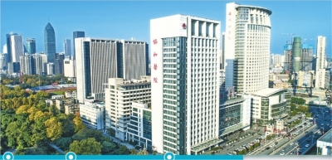
武汉协和医院关于“新冠”中医防治方案（第三版）

Slide 62
Wuhan Union Hospital 武汉协和医院
Prevention 预防
Wind-Heat Invading the Exterior Syndrome 风熱袭表证
Damp Warmth in Early Phase 濕溫初期
Damp Heat Obstructing the Lung Syndrome 濕熱壅肺証
Epidemic Toxins Blocking the Lung 疫毒闭肺证
Closed Interior and Abandoned Exterior 内闭外脱
Insufficiency of qi and yin, Deficiency of Lung and Spleen. 气阴不足，肺脾两虚
武汉协和医院关于“新冠”中医防治方案（第三版）

Slide 63
Prevention 预防
Huang Qi 生黄芪 (Radix Astragali) 12g
Bai Zhu 白术 (Rhizoma Atractylodis Macrocephalae) 9g
Fang Feng 防风 (Radix Saposhnikoviae) 6g
Bei Sha Shen 北沙参 (Radix Glehniae) 10g
Mian Ma Guan Zhong 贯众 (Rhizoma Dryopteridis Crassirhizomatis) 10g
Lian Qiao 连翘 (Fructus Forsythiae) 10g
Yu Xing Cao 鱼腥草 (Herba Houttuyniae) 15g
Jie Geng 桔梗 (Radix Platycodonis) 10g
Gan Cao 甘草 (Radix et Rhizoma Glycyrrhizae) 5g
Cang Zhu 苍术 (Rhizoma Atractylodis) 10g
Yi Yi Ren 薏苡仁 (Semen Coicis) 30g
Guang Huo Xiang 藿香 (Herba Pogostemonis) 5g
Fu Shen 茯神 (Poria Paradicis) 15g

Slide 64
Wind-Heat Invading Exterior Syndrome 风熱袭表证
S/sx: headache, sore throat, cough, thick tongue coating, red tongue tip

Slide 65
Wind-Heat Invading Exterior Syndrome 风熱袭表证
Jin Yin Hua 金银花 (Flos Lonicerae Japonicae) 15g
Lian Qiao 连翘 (Fructus Forsythiae) 10g
Bo He 薄荷 (Herba Menthae) 5g
Niu Bang Zi 牛蒡子 (Fructus Arctii) 10g
Ban Xia 法半夏 (Rhizoma Pinelliae) 10g
Chai Hu 柴胡 (Radix Bupleuri) 10g
Huang Qin 黄芩 (Radix Scutellariae) 10g
Ban Lan Gen 板蓝根 (Radix Isatidis) 15g
Jie Geng 桔梗 (Radix Platycodonis) 10g
Gan Cao 甘草 (Radix et Rhizoma Glycyrrhizae) 6g
Xuan Shen 玄参 (Radix Scrophulariae) 15g
She Gan 射干 (Rhizoma Belamcandae) 10g
Fang Feng 防风 (Radix Saposhnikoviae) 10g
Ku Xing Ren 苦杏仁 (Semen Armeniacae Amarum) 10g
Qiang Huo 羌活 (Rhizoma et Radix Notopterygii) 10g
Cang Zhu 苍术 (Rhizoma Atractylodis) 10g
Dou Kou 蔻仁 (Fructus Amomi Rotundus) 6g

Slide 66
Damp Warmth in Early Phase 濕溫初期
S/sx: muscle aches and pain, poor appetite, low grade fever, thick tongue coating

Slide 67
Damp Warmth in Early Phase 濕溫初期
Jin Yin Hua 金银花 (Flos Lonicerae Japonicae) 25g
Lian Qiao 连翘 (Fructus Forsythiae) 15g
Sheng Ma 升麻 (Rhizoma Cimicifugae) 25g
Dang Gui 当归 (Radix Angelicae Sinensis) 15g
Ban Xia 法半夏 (Rhizoma Pinelliae) 10g
Ju Hong 橘红 (Exocarpium Citri Rubrum) 10g
Fu Ling 茯苓 (Poria) 15g
Cang Zhu 苍术 (Rhizoma Atractylodis) 15g
Da Fu Pi 大腹皮 (Pericarpium Arecae) 15g
Chai Hu 柴胡 (Radix Bupleuri) 10g
Huang Qin 黄芩 (Radix Scutellariae) 15g
Ku Xing Ren 杏仁 (Semen Armeniacae Amarum) 10g
Guang Huo Xiang 藿香 (Herba Pogostemonis) 10g
Hou Po 厚朴 (Cortex Magnoliae Officinalis) 6g
She Gan 射干 (Rhizoma Belamcandae) 10g
Zhi Qiao 枳壳 (Fructus Aurantii) 10g
Zhu Ru 竹茹 (Caulis Bambusae in Taenia) 10g
Ma Huang 炙麻黄 (Herba Ephedrae), honey-baked 6g
Hong Jing Tian 红景天 (Radix et Rhizoma Rhodiolae Crenulatae) 10g

Slide 68
Damp Heat Obstructing Lung Syndrome 濕熱壅肺証
S/sx: dry cough, shortness of breath

Slide 69
Damp Heat Obstructing Lung Syndrome濕熱壅肺証
Sang Bai Pi 桑白皮 (Cortex Mori) 15g
Chuan Bei Mu 川贝 (Bulbus Fritillariae Cirrhosae) 10g
Bai Bu 百部 (Radix Stemonae) 10g
Yu Xing Cao 鱼腥草 (Herba Houttuyniae) 30g
Lian Qiao 连翘 (Fructus Forsythiae) 15g
Bai Jiang Cao 败酱草 (Herba cum Radice Patriniae) 15g
Yi Yi Ren 薏苡仁 (Semen Coicis) 15g
Mai Dong 麦冬 (Radix Ophiopogonis) 15g
Lu Gen 芦根 (Rhizoma Phragmitis) 25g
Dong Gua Zi 冬瓜仁 (Semen Benincasae) 10g
Jie Geng 桔梗 (Radix Platycodonis) 10g
Ku Xing Ren 苦杏仁 (Semen Armeniacae Amarum) 10g
Chai Hu 柴胡 (Radix Bupleuri) 10g
Huang Qin 黄芩 (Radix Scutellariae) 15g
Hou Po 厚朴 (Cortex Magnoliae Officinalis) 10g
Hong Jing Tian 红景天 (Radix et Rhizoma Rhodiolae Crenulatae) 15g
Sheng Ma 升麻 (Rhizoma Cimicifugae) 30g
Dang Gui 当归 (Radix Angelicae Sinensis) 25g
Bing Lang 槟榔 (Semen Arecae) 10g
Cao Guo 草果 (Fructus Tsaoko) 6g
Zhi Mu 知母 (Rhizoma Anemarrhenae) 10g
Bai Shao 芍药 (Radix Paeoniae Alba) 10g
Chao San Xian 炒三仙: Shen Qu (Massa Medicata Fermentata), Shan Zha (Fructus Crataegi) and Mai Ya (Fructus Hordei Germinatus), blend & dry-fry together 20g

Slide 70
Epidemic Toxins Blocking the Lung
疫毒闭肺证
S/sx: fever, severe breathing difficulties, wheezing, severe hypoxemia, dark red tongue, thick tongue coating

Slide 71
Epidemic Toxins Blocking the Lung
疫毒闭肺证
Ting Li Zi 葶苈子 (Semen Descurainiae seu Lepidii) 15g
Ma Huang 炙麻黄 (Herba Ephedrae), honey-fried 10g
Sheng Ma 升麻 (Rhizoma Cimicifugae) 30g
Dang Gui 当归 (Radix Angelicae Sinensis) 25g
Lu Gen 芦根 (Rhizoma Phragmitis) 25g
Yi Yi Ren 薏米仁 (Semen Coicis) 30g
Dong Gua Zi 冬瓜仁 (Semen Benincasae) 15g
Tao Ren 桃仁 (Semen Persicae) 12g
Ban Xia 法半夏 (Rhizoma Pinelliae) 10g
Gua Lou Pi 瓜蒌皮(Pericarpium Trichosanthis) 15g
Cang Zhu 苍术 (Rhizoma Atractylodis) 15g
Jie Geng 桔梗 (Radix Platycodonis) 10g
Jiang Huang 姜黄 (Rhizoma Curcumae Longae) 10g
Chan Tui 蝉蜕 (Periostracum Cicadae) 6g
Jiang Can 僵蚕 (Bombyx Batryticatus) 10g
Da Huang 熟大黃 (Radix et Rhizoma Rhei), cooked 6g
Yu Xing Cao 鱼腥草 (Herba Houttuyniae) 30g
Jin Yin Hua 金银花 (Flos Lonicerae Japonicae) 15g
Lian Qiao 连翘 (Fructus Forsythiae) 15g
Shi Gao 石膏 (Gypsum Fibrosum) 20g

Slide 72
Closed Interior and Abandoned Exterior内闭外脱
S/sx: high fever, delirium, restlessness, irritability, burning sensations in the chest and abdomen, cold hands and feet, hurried breathing, ECMO needed.

Slide 73
Closed Interior and Abandoned Exterior内闭外脱
四逆加人参汤、安宫牛黄丸 (Si Ni Jia Ren Shen Tang (Frigid Extremities Decoction plus Ginseng), An Gong Niu Huang Wan (Calm the Palace Pill with Cattle Gallstone)
An Gong Niu Huang Wan (Calm the Palace Pill with Cattle Gallstone) plus Ren Shen (Radix et Rhizoma Ginseng) 15g, Fu Zi (Radix Aconiti Lateralis Praeparata) 15g, Gan Cao (Radix et Rhizoma Glycyrrhizae) 10g, Shi Chang Pu (Rhizoma Acori Tatarinowii) 10g
If needed, intravenous infusion of Shenfu 参附 Injection, Shengmai 生脉 Injection

Slide 74
Insufficiency of qi and yin, Deficiency of Lung and Spleen. 气阴不足，肺脾两虚
S/sx: dry cough, feeling of chest oppression, shortness of breath, dyspnea upon movement

Slide 75
Insufficiency of qi and yin, Deficiency of Lung and Spleen. 气阴不足，肺脾两虚
Sha Shen 沙参 (Radix Glehniae seu Adenophorae) 15g
Mai Dong 麦冬 (Radix Ophiopogonis) 15g
Yu Zhu 玉竹 (Rhizoma Polygonati Odorati) 10g
Tian Hua Fen 天花粉 (Radix Trichosanthis) 15g
Xi Yang Shen 西洋参 (Radix Panacis Quinquefolii) 10g
Wu Wei Zi 五味子 (Fructus Schisandrae Chinensis) 10g
Si Gua Luo 丝瓜络 (Retinervus Luffae Fructus) 15g
Bai Bian Dou扁豆 (Semen Lablab Album) 10g
Sang Ye 桑叶 (Folium Mori) 10g
Ju Luo 橘络 (Vascular Citri Reticulatae) 5g
Zi Su Zi 苏子 (Fructus Perillae) 10g
Zhe Bei Mu 浙贝 (Bulbus Fritillariae Thunbergii) 10g
Ku Xing Ren 杏仁 (Semen Armeniacae Amarum) 10g
Gan Cao 甘草 (Radix et Rhizoma Glycyrrhizae) 6g
Di Long 地龙 (Pheretima) 10g

Slide 76
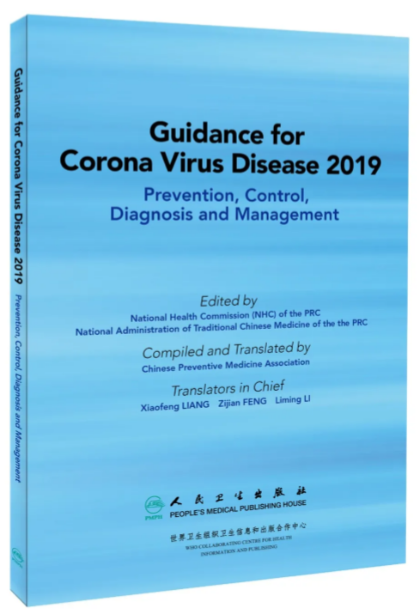
英文版全文 _ 新型冠状病毒肺炎防控和诊疗指南 https://mp.weixin.qq.com/s/nOAmosQ4YqkXHKdJbBE9GA

Slide 77
Guidance for Corona Virus Disease 2019
Medical Observation Period 医学观察
Clinical Treatment Period 临床治疗
Recovery Period 恢复期
英文版全文 _ 新型冠状病毒肺炎防控和诊疗指南
https://mp.weixin.qq.com/s/nOAmosQ4YqkXHKdJbBE9GA

Slide 78
Guidance for Corona Virus Disease 2019
Medical Observation Period 医学观察
Clinical Treatment Period 临床治疗
  Cold Dampness Stagnating Lungs 寒湿郁肺证
  Damp-Heat Accumulated Lung 湿热蘊肺证
  Damp-Poison Stagnating Lung 湿毒郁肺证
  Cold Dampness Obstructing Lung 寒湿阻肺证
  Lung Blocked by Epidemic Toxin 疫毒闭肺证
  Flaring Heat in Qi and Ying 气营两燔
  Internal Block and Outward Desertion 内闭外脱
Recovery Period 恢复期
  Lung and Spleen Qi Deficiency 肺脾气虚证
  Deficiency of Qi and Yin 气阴两虚证

Slide 79
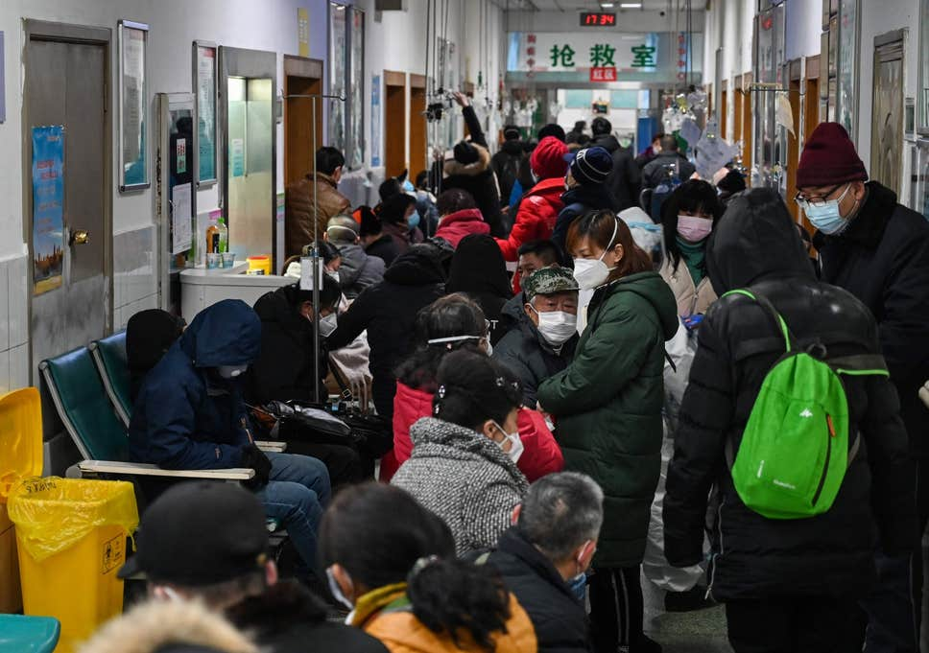

Slide 80
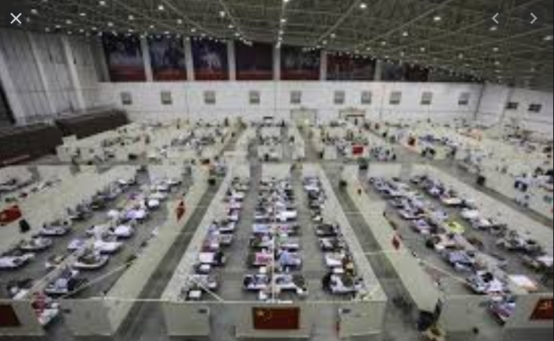

Slide 81
Qing Fei Pai Du Tang 清肺排毒汤
(Clear the Lung and Eliminate Toxins Decoction)
Ma Huang (Herba Ephedrae), 9g
Zhi Gan Cao (Radix et Rhizoma Glycyrrhizae Praeparata cum Melle), 6g
Ku Xing Ren (Semen Armeniacae Amarum), 9g
Shi Gao (Gypsum Fibrosum), 15-30g (pre-decoct)
Gui Zhi (Ramulus Cinnamomi), 9g
Ze Xie (Rhizoma Alismatis), 9g
Zhu Ling (Polyporus), 9g
Bai Zhu (Rhizoma Atractylodis Macrocephalae), 9g
Fu Ling (Poria), 15g
Chai Hu (Radix Bupleuri), 16g
Huang Qin (Radix Scutellariae), 6g
Jiang Ban Xia (Rhizoma Pinelliae Praeparatum cum Zingibere et Alumine), 9g
Sheng Jiang (Rhizoma Zingiberis Recens), 9g
Zi Wan (Radix et Rhizoma Asteris), 9g
Kuan Dong Hua (Flos Farfarae), 9g
She Gan (Rhizoma Belamcandae), 9g
Xi Xin (Radix et Rhizoma Asari), 6g
Shan Yao (Rhizoma Dioscoreae), 12g
Zhi Shi (Fructus Aurantii Immaturus), 6g
Chen Pi (Pericarpium Citri Reticulatae), 6g
Guang Huo Xiang (Herba Pogostemonis), 9g
国家中医药管理局; https://mp.weixin.qq.com/s/0U9tAMdfQfrWZz_43Bc0bg

Slide 82
Qing Fei Pai Du Tang 清肺排毒汤
(Clear the Lung and Eliminate Toxins Decoction)
Ma Huang Xing Ren Gan Cao Shi Gao Tang 麻杏甘石湯
(Ephedra, Apricot Kernel, Licorice, Gypsum Decoction)
Xiao Chai Hu Tang 小柴胡湯
(Minor Bupleurum Decoction)
She Gan Ma Huang Tang 射干麻黃湯
(Belamcanda and Ephedra Decoction)
Wu Ling San 五苓散
(Five-Ingredient Powder with Poria)
国家中医药管理局; https://mp.weixin.qq.com/s/0U9tAMdfQfrWZz_43Bc0bg

Slide 83
Qing Fei Pai Du Tang 清肺排毒汤
(Clear the Lung and Eliminate Toxins Decoction)
Drink the warm decoction twice daily 40 minutes after meals. Folllow with half to one bowl of rice porridge.
Dosage of Shi Gao (Gypsum Fibrosum) should be adjusted based on severity of fever.
国家中医药管理局; https://mp.weixin.qq.com/s/0U9tAMdfQfrWZz_43Bc0bg

Slide 84
Qing Fei Pai Du Tang 清肺排毒汤
(Clear the Lung and Eliminate Toxins Decoction)
701 patients in 10 provinces:
  130 recovered and discharged
  51 resolution of s/sx
  268 improvement of s/sx
  212 stabilization of s/sx
  94.3% rate of effectiveness
国家中医药管理局; https://mp.weixin.qq.com/s/0U9tAMdfQfrWZz_43Bc0bg

Slide 85
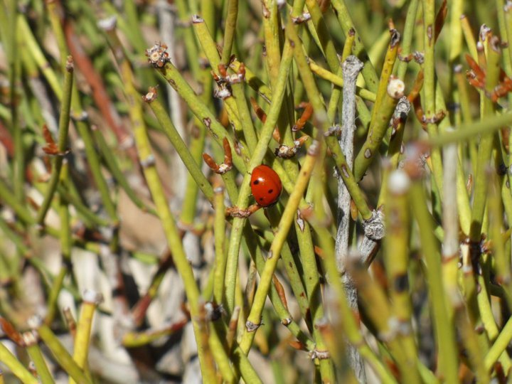
Ma Huang (Herba Ephedrae)
Ephedra sinica, Ephedra intermedia, Ephedra equisetina
  Ephedrine alkaloids 0.481-2.47% (l-ephedrine, d-pseudoephedrine, l-norephedrine, d-norpseudoephedrine, l-methylephedrine, d-methylpseudoephedrine)
Ephedra nevadensis
aka: momon tea
.
  No ephedrine alkaloids
Chen J and Chen T. Chinese Medical Herbology and Pharmacology. Art of Medicine Press. 2004.

Slide 86
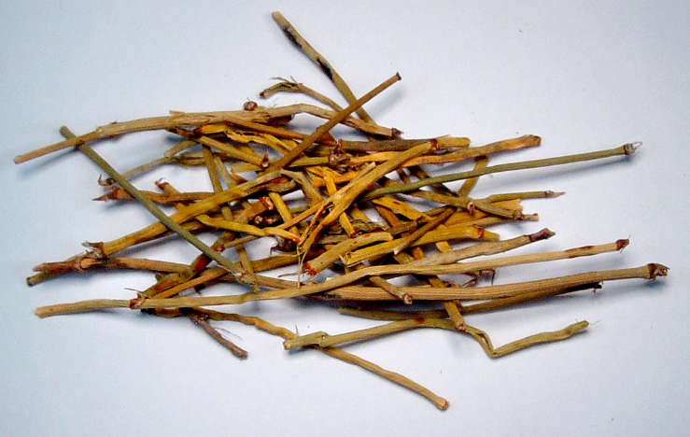
Ma Huang (Herba Ephedrae)
Relieves wheezing and dyspnea, stops cough
  Di Long (Pheretima)
  Ku Xing Ren (Semen Armeniacae Amarum)
  Zi Su Zi (Fructus Perillae)
Chen J and Chen T. Chinese Medical Herbology and Pharmacology. Art of Medicine Press. 2004.

Slide 87
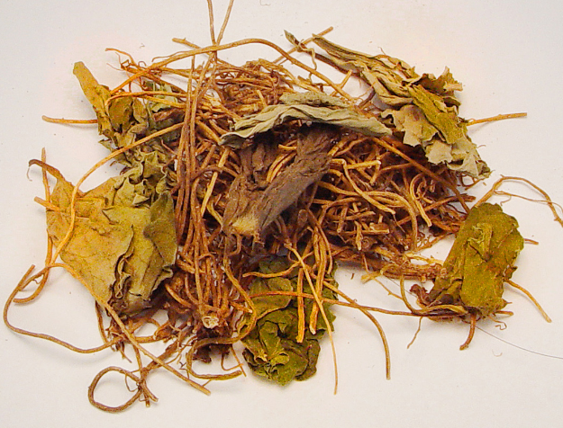
Xi Xin (Radix et Rhizoma Asari)
Dispels exterior wind-cold
  Qiang Huo (Rhizoma et Radix Notopterygii)
  Fang Feng (Radix Saposhnikoviae)
Warms the lung and resolves phlegm
  Gan Jiang (Rhizoma Zingiberis)
  Jie Zi (Semen Sinapis)
Chen J and Chen T. Chinese Medical Herbology and Pharmacology. Art of Medicine Press. 2004.

Slide 88
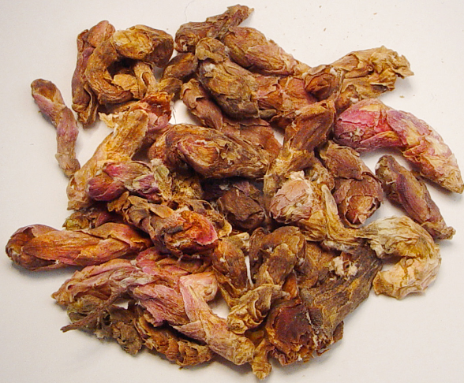
Kuan Dong Hua (Flos Farfarae)
Moistens the Lung, descends qi, dissolves phlegm, stops cough
  Ku Xing Ren (Semen Armeniacae Amarum)
  Zi Wan (Radix et Rhizoma Asteris)
  Zi Su Zi (Fructus Perillae)
Chen J and Chen T. Chinese Medical Herbology and Pharmacology. Art of Medicine Press. 2004.

Slide 89
Hubei Provincial Hospital | Wuhan Union Hospital | Guidance for Covid-19
Prevention Phase | Prevention
Early Phase | Wind-Heat Invading the Exterior Syndrome | Medical Observation Period
Pneumonia Phase | Damp Warmth in Early Phase Damp Heat Obstructing the Lung Syndrome Epidemic Toxins Blocking the Lung Closed Interior and Abandoned Exterior | Clinical Treatment Period
Recovery Phase | Insufficiency of qi and yin, Deficiency of Lung and Spleen. | Recovery Period

Slide 90

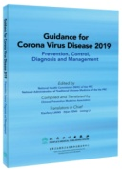

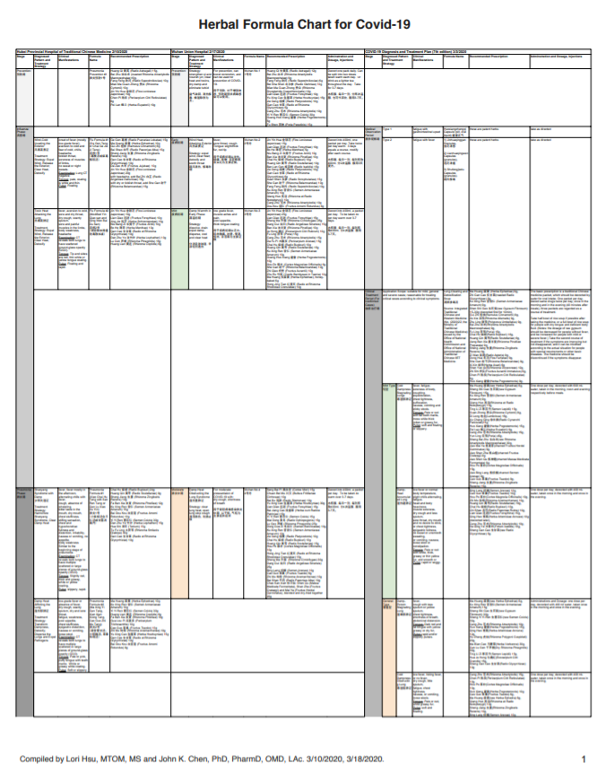
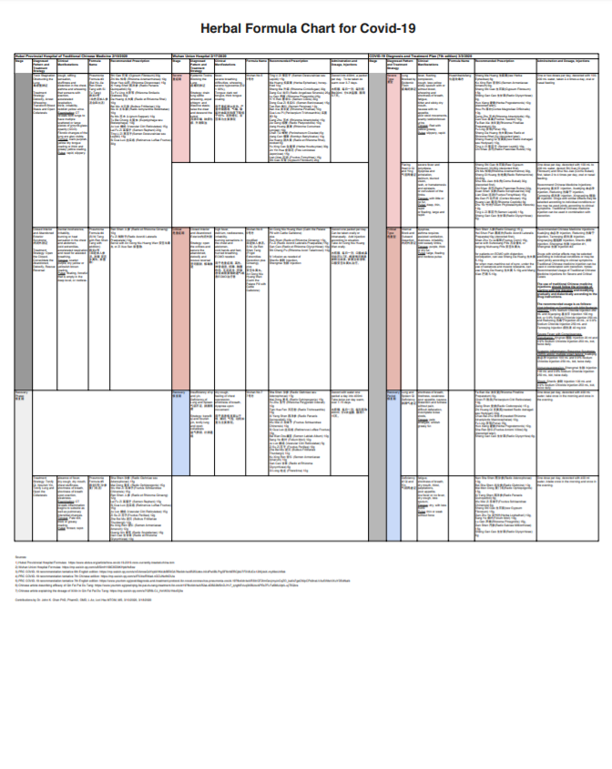
https://www.elotus.org/promo-files/COVID-19_resources/COVID-19%20Formula%20Charts%20v3.pdf

Slide 91
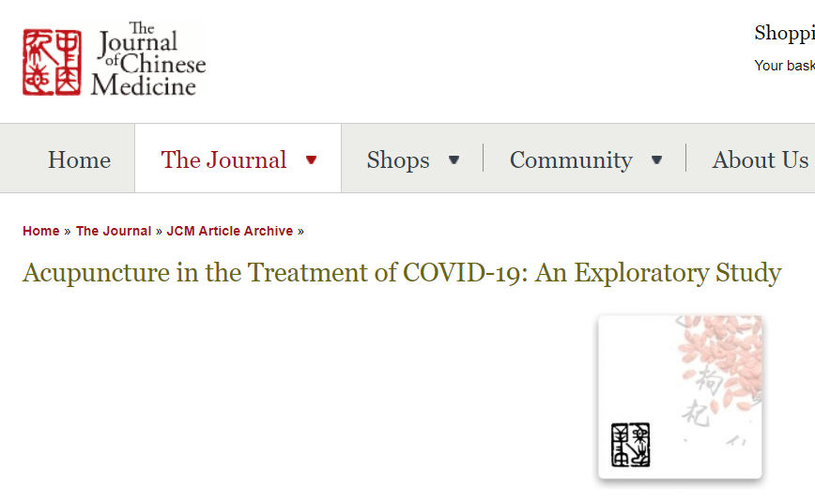
https://www.journalofchinesemedicine.com/acupuncture-in-the-treatment-of-covid-19-an-exploratory-study.html?fbclid=IwAR2dUlmkqaEHnjjP5-jcJepRq6G2R8BkSWnTE510-axx57HJdRaszd1pgJQ

Slide 92
Research
Pharmacological research of single herbs
Clinical research of herbal formulas

Slide 93
Research
Pharmacological research of single herbs
  Huang Qi (Radix Astragali)
  Jin Yin Hua (Flos Lonicerae Japonicae)
  Ban Lan Gen (Radix Isatidis)
  Yu Xing Cao (Herba Houttuyniae)
  Xiang Chun Ye (Folium Toonae Sinensis)
  Wu Bei Zi (Galla Chinensis)

Slide 94
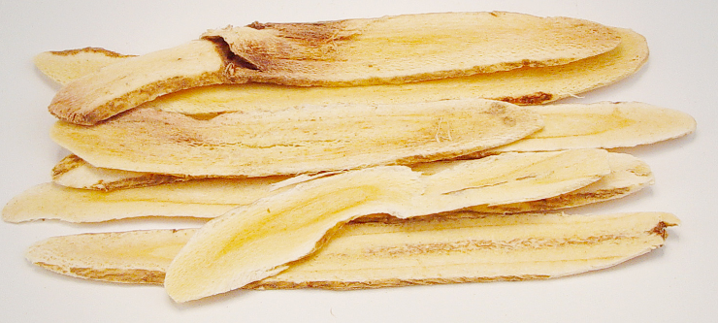
  Huang Qi (Radix Astragali)
Tonifies qi and raises yang
Tonifies wei (defensive) qi, consolidates the exterior
Promotes the discharge of pus and generates flesh
Regulates water circulation, reduces edema
Relieves numbness and pain
Chen J and Chen T. Chinese Medical Herbology and Pharmacology. Art of Medicine Press. 2004.

Slide 95
  Huang Qi (Radix Astragali)
Immunostimulant:
  Administration of Huang Qi (Radix Astragali) is associated with promotion of T cells.
  The polysaccharides from Huang Qi (Radix Astragali) have been shown to activate B cells.
Qu LL, et al. Astragalus membranaceus injection delayed allograft survival related with CD4+ CD25+ regulatory T cells. Transplant Proc. 2010 Nov;42(9):3793-7.
Shao BM, et al. A study on the immune receptors for polysaccharides from the roots of Astragalus membranaceus, a Chinese medicinal herb. Biochem Biophys Res Commun. 2004 Aug 6;320(4):1103-11.

Slide 96
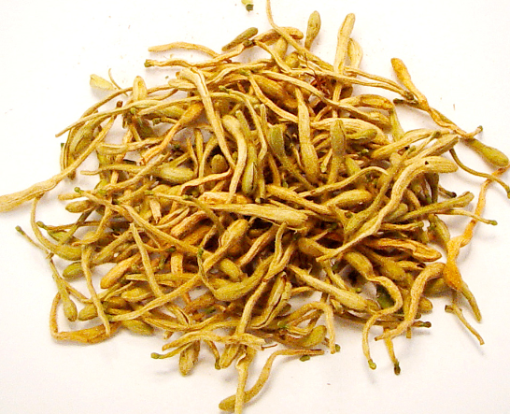
  Jin Yin Hua (Flos Lonicerae Japonicae)
Clears heat
Clears heat and eliminates toxins
Chen J and Chen T. Chinese Medical Herbology and Pharmacology. Art of Medicine Press. 2004.

Slide 97
  Jin Yin Hua (Flos Lonicerae Japonicae)
Antibacterial
Antiviral
Chen J and Chen T. Chinese Medical Herbology and Pharmacology. Art of Medicine Press. 2004.

Slide 98
  Jin Yin Hua (Flos Lonicerae Japonicae)
Antibacterial: Jin Yin Hua has a broad spectrum of inhibitory actions against Staphylococcus aureus, beta-hemolytic streptococcus, E. coli, Bacillus dysenteriae, Vibrio cholerae, Salmonella typhi, Diplococcus pneumoniae, Diplococcus meningitidis, Pseudomonas aeruginosa, and Mycobacterium tuberculosis. Chlorogenic acid and isochlorogenic acid have the strongest antibiotic effects.
Xin Yi Xue (New Medicine), 1975; 6(3):155.
Jiang Xi Xin Yi Yao (Jiangxi New Medicine and Herbology); 1960;(1):34.

Slide 99
  Jin Yin Hua (Flos Lonicerae Japonicae)
Antiviral: Shuangkangsu, a cyclic peroxide from Jin Yin Hua, has significant antiviral activities against influenza virus and respiratory syncytial. The homosecoiridoid alkaloids of Jin Yin Hua have antiviral activity against the influenza virus H3N2 (A/Hanfang/359/95) and coxsackie virus B3. The glucosylated caffeoylquinic acid isomers from Jin Yin Hua shows inhibitory activity against coxsackie virus B3.
Yu DQ, et al. The structure and absolute configuration of Shuangkangsu: a novel natural cyclic peroxide from Lonicera japonica (Thunb.). J Asian Nat Prod Res. 2008 Sep-Oct;10(9-10):851-6.
Yu Y, et al. Homosecoiridoid alkaloids with amino acid units from the flower buds of Lonicera japonica. J Nat Prod. 2013 Dec 27;76(12):2226-33.
Yu Y, et al. Glucosylated caffeoylquinic acid derivatives from the flower buds of Lonicera japonica. Acta Pharm Sin B. 2015 May;5(3):210-4.

Slide 100
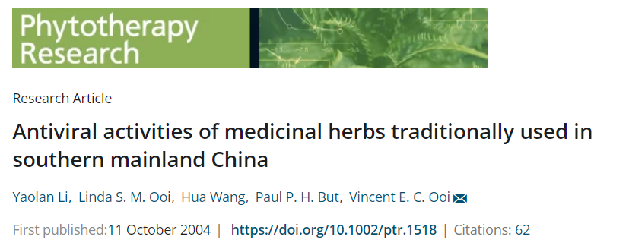
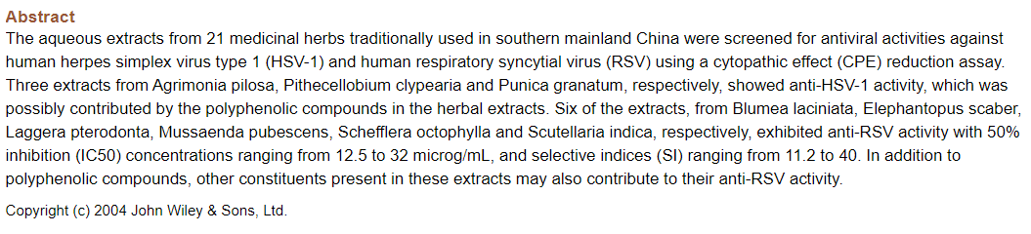

Slide 101
Jin Yin Hua (Flos Lonicerae Japonicae)
Jin Yin Hua inhibits SARS-CoV replication at non-toxic concentration, of 21 herbs tested.
  Others require high concentration.
Li Y, Ooi LS, Wang H, But PP, Ooi VE. Antiviral activities of medicinal herbs traditionally used in
southern mainland China. Phytother Res 2004; 18: 718-722.

Slide 102
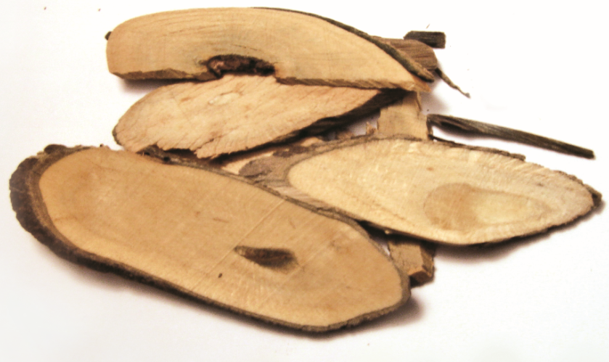
Ban Lan Gen (Radix Isatidis)
Clears heat, eliminates toxins, cools blood and benefits the throat
Chen J and Chen T. Chinese Medical Herbology and Pharmacology. Art of Medicine Press. 2004.

Slide 103
Ban Lan Gen (Radix Isatidis)
Antibacterial
Antitoxin
Antiviral
Anti-inflammatory
Chen J and Chen T. Chinese Medical Herbology and Pharmacology. Art of Medicine Press. 2004.

Slide 104
Ban Lan Gen (Radix Isatidis)
Antiviral: Ban Lan Gen exerts antiviral effect against influenza A virus, seasonal influenza virus, human or avian influenza virus, novel swine-originating influenza virus, Japanese encephalitis virus, adenovirus, herpes simplex virus, hepatitis B virus, human cytomegalovirus, swine pseudorabies virus, coxsackie virus B₃.
Hsuan SL, et al. The cytotoxicity to leukemia cells and antiviral effects of Isatis indigotica extracts on pseudorabies virus. J Ethnopharmacol. 2009 May 4;123(1):61-7. Epub 2009 Mar 4.
Chen C, et al. Zhongyao Yaolixue, 2nd Edition. Shanghai Science and Technology Publishing, 2015; 88-90.
Yang Z, et al. Antiviral activity of Isatis indigotica root-derived clemastanin B against human and avian influenza A and B viruses in vitro. Int J Mol Med. 2013 Apr;31(4):867-73.
Wang XL, et al. Chemical consitituents from root of Isatis indigotica. Zhongguo Zhong Yao Za Zhi. 2013 Apr;38(8):1172-82.

Slide 105
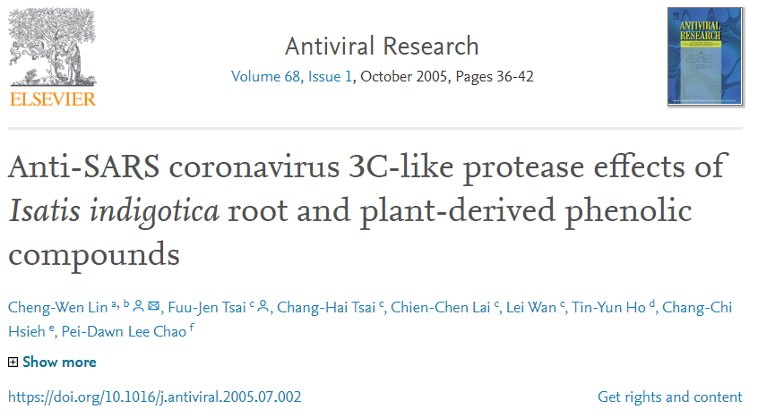
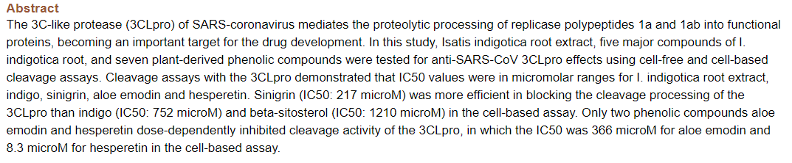

Slide 106
Ban Lan Gen (Radix Isatidis)
Ban Lan Gen shows direct effect to inhibit the enzyme activity of SARS coronavirus.
Lin CW, Tsai FJ, Tsai CH, Lai CC, Wan L, Ho TY, et al. AntiSARS coronavirus 3C-like protease effects of
Isatis indigotica root and plant-derived phenolic compounds. Antiviral Res 2005; 68: 36-42.

Slide 107
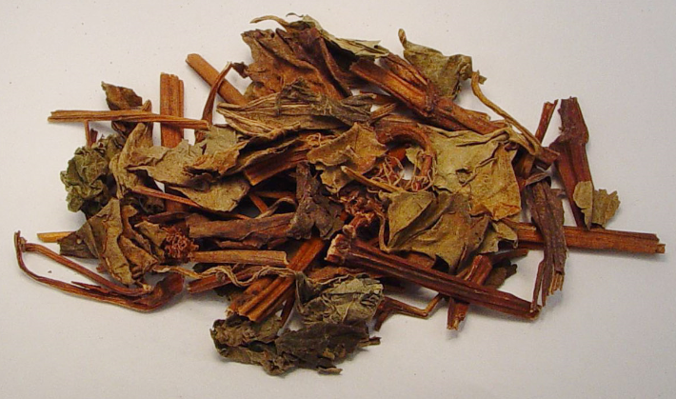
Yu Xing Cao (Herba Houttuyniae)
Clears heat, eliminates toxins and drains pus
Promotes normal urination
Chen J and Chen T. Chinese Medical Herbology and Pharmacology. Art of Medicine Press. 2004.

Slide 108
Yu Xing Cao (Herba Houttuyniae)
Antibacterial
Antiviral
Anti-inflammatory
Chen J and Chen T. Chinese Medical Herbology and Pharmacology. Art of Medicine Press. 2004.

Slide 109
Yu Xing Cao (Herba Houttuyniae)
Antiviral and virucidal: Yu Xing Cao has antiviral effect against numerous types of viruses: herpes simplex virus (HSV), acyclovir-resistant HSV, H1N1 influenza virus, pseudorabies herpes, influenza virus, and human immunodeficiency virus.
Chiang LC, et al. Anti-Herpes simplex virus activity of Bidens pilosa and Houttuynia cordata. Am J Chin Med. 2003;31(3):355-62.
Chou SC, et al. The constituents and their bioactivities of Houttuynia cordata. Chem Pharm Bull (Tokyo). 2009 Nov;57(11):1227-30.
Ren X, et al. The effect of Houttuynia cordata injection on pseudorabies herpesvirus (PrV) infection in vitro. Pharm Biol. 2011 Feb;49(2):161-6.
Hayashi K, et al. Virucidal effects of the steam distillate from Houttuynia cordata and its components on HSV-1, influenza virus, and HIV. Planta Med. 1995 Jun;61(3):237-41.

Slide 110
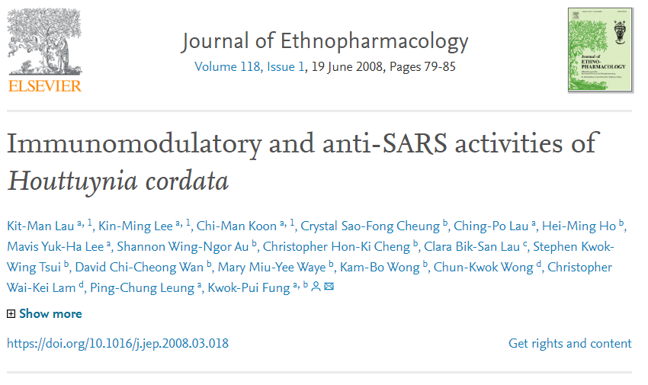
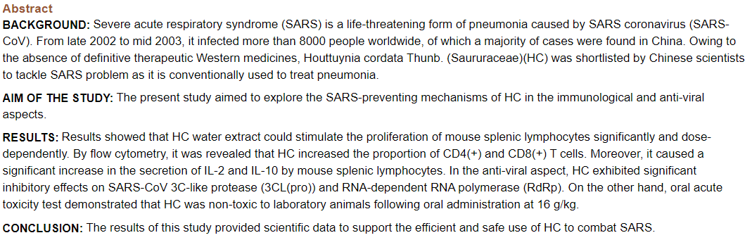

Slide 111
Yu Xing Cao (Herba Houttuyniae)
The water extract of Yu Xing Cao also demonstrates antiviral effect to treat coronavirus in severe acute respiratory syndrome (SARS).
Yu Xing Cao exhibits significant inhibitory effects on the virus, and increases the proliferation of lymphocytes in a dose-dependent manner.
Lau KM, et al. Immunomodulatory and anti-SARS activities of Houttuynia cordata. Institute of Chinese Medicine,
The Chinese University of Hong Kong, Shatin, Hong Kong SAR, China. J Ethnopharmacol. 2008 Jun 19;118(1):79-85.

Slide 112
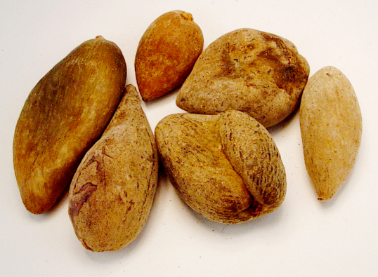
Wu Bei Zi (Galla Chinensis)
Contains leakage of lung qi, clears deficiency fire
Binds the intestines
Consolidates kidney jing (essence)
Restrains sweating
Stops bleeding
Eliminates toxins and reduces swelling
Chen J and Chen T. Chinese Medical Herbology and Pharmacology. Art of Medicine Press. 2004.

Slide 113
Wu Bei Zi (Galla Chinensis)
Antiviral: Administration of moronic acid from Wu Bei Zi is associated with antiviral effect against Epstein-Barr virus via the inhibition of the lytic cycle. Wu Bei Zi also shows antiviral activities against HIV-1 virus by inhibiting HIV-1 viral replication. The main active compounds include rhuscholide A, betulonic acid, moronic acid, and others.
Chang FR, et al. Inhibition of the Epstein-Barr virus lytic cycle by moronic acid. Graduate Institute of Natural Products, Antiviral Res. 2010 Mar;85(3):490-5.
Wang RR, et al. Anti-HIV-1 activities of compounds isolated from the medicinal plant Rhus chinensis. J Ethnopharmacol. 2008 May 8;117(2):249-56.
Gu Q, et al. A new benzofuranone and anti-HIV constituents from the stems of Rhus chinensis. Planta Med. 2007 Mar;73(3):279-82.

Slide 114
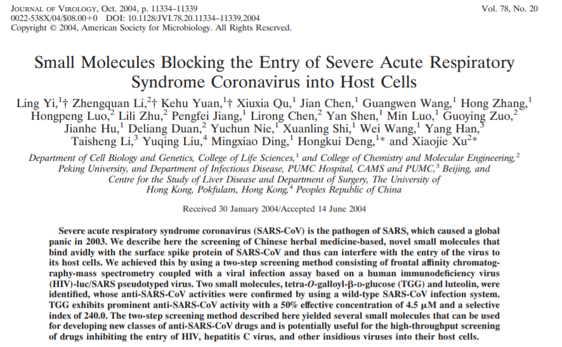
https://www.ncbi.nlm.nih.gov/pubmed/15452254

Slide 115
Wu Bei Zi (Galla Chinensis)
Wu Bei Zi (Galla Chinensis) contains tetra-O-galloyl-β-D-glucose (TGG) and luteolin, were identified to exhibit prominent anti-SARS virus activity.
These natural molecules bound avidly with the surface spike protein of SARS virus and thus interfered with the entry of the virus to its host cells.
Yi L, Li Z, Yuan K, Qu X, Chen J, Wang G, et al. Small molecules blocking the entry of severe acute respiratory syndrome coronavirus into host cells. J Virol 2004; 78: 1133411339.

Slide 116
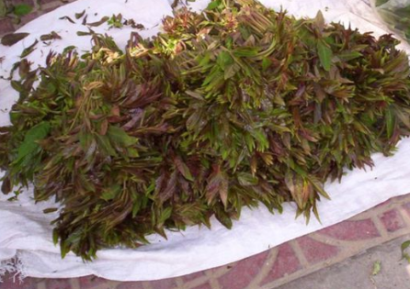
Xiang Chun Ye (Folium Toonae Sinensis)
Xiang Chun Ye clears heat and eliminates toxins to treat Lung heat with cough.
It also clears heat and eliminates toxins from the skin to treat sores and abscesses.
香椿葉
Chen J and Chen T. Chinese Medical Herbology and Pharmacology. Art of Medicine Press. 2004.

Slide 117
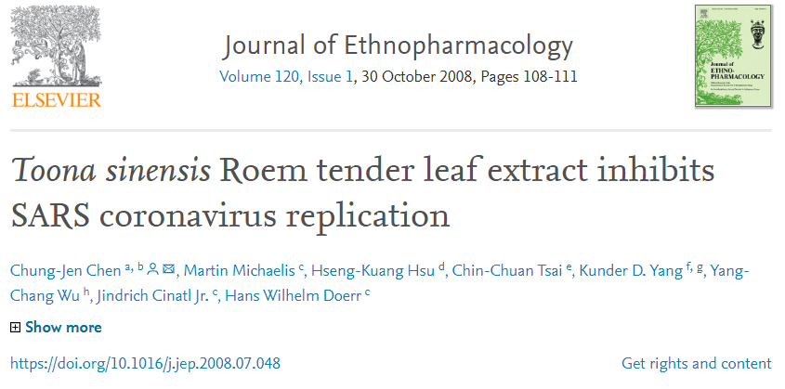
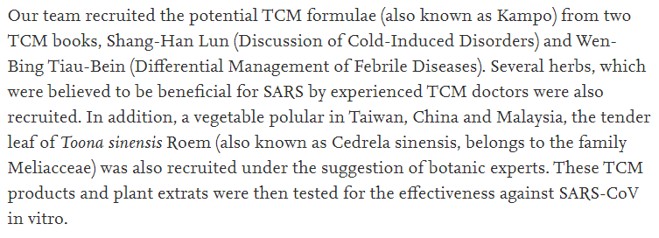
https://www.sciencedirect.com/science/article/pii/S0378874108004200?via%3Dihub

Slide 118
Xiang Chun Ye (Folium Toonae Sinensis)
Xiang Chun Ye (Folium Toonae Sinensis) contains a compound (TSL-1) that selectively bind to SARS-CoV virus to inhibit the cellular entry of the virus into the host cells.
Xiang Chun Ye inhibits the replication of coronavirus to treat severe acute respiratory syndrome (SARS).
Chen CJ, et al. Toona sinensis Roem tender leaf extract inhibits SARS coronavirus replication.
J Ethnopharmacol. 2008 Oct 30;120(1):108-11.

Slide 119
Xiang Chun Ye (Folium Toonae Sinensis)
Xiang Chun Ye is the most effective herb of all tested from Shang Han Lun (Discussion of Cold-Induced Disorders) and Wen Bing Tiao Bian (Systematic Differentiation of Warm Disease).
Chen CJ, et al. Toona sinensis Roem tender leaf extract inhibits SARS coronavirus replication.
J Ethnopharmacol. 2008 Oct 30;120(1):108-11.

Slide 120
Research
Clinical research of herbal formulas
  Yu Ping Feng San (Jade Windscreen Powder)

Slide 121
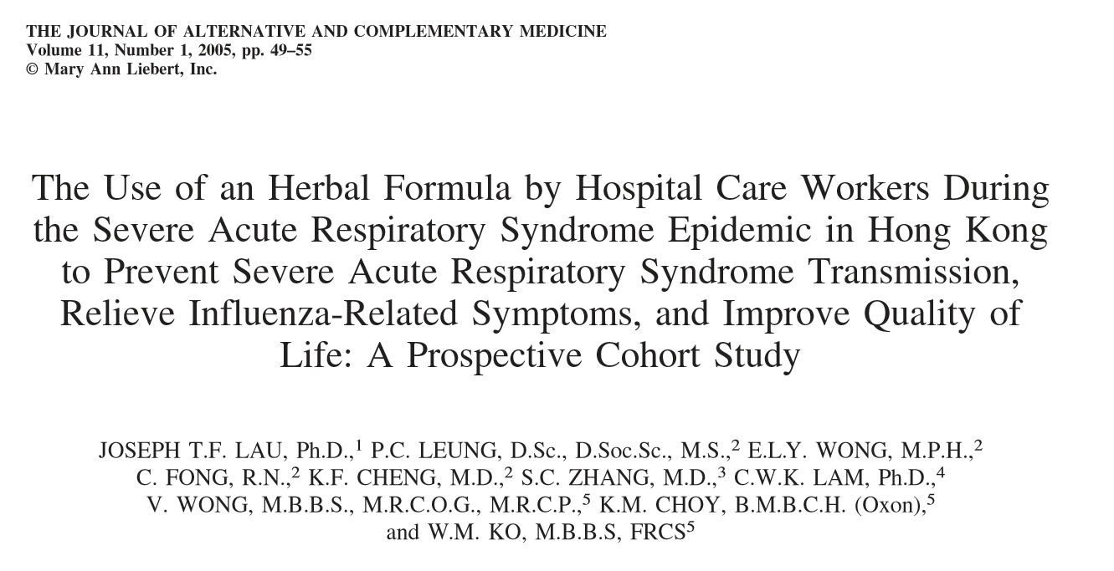
Prevention of SARS
The Use of an Herbal Formula by Hospital Care Workers During the Severe Acute Respiratory Syndrome Epidemic in Hong Kong to Prevent Severe Acute Respiratory Syndrome Transmission, Relieve Influenza-Related Symptoms, and Improve Quality of Life: A Prospective Cohort Study
Lau J, Leung P, Wong E, Fong C, Cheng K, Zhang S, et al. The use of an herbal formula by hospital
care workers during the severe acute respiratory syndrome epidemic in Hong Kong to prevent severe
acute respiratory. J Alternat Complement Med 2005;11:49-55.

Slide 122
Prevention of SARS
Study: 16,437 hospital care workers, including doctors, nurses and others 11 hospitals in Hong Kong
  1,063 herb group
  15,374 in non-herb group
Luo, H, Tang Q, Shang, Y et al. Can Can Chinese Medicine Be Used for Prevention of Corona Virus
Disease 2019 (COVID-19) Chinesee Journal of Integrative Medicine.
Lau J, Leung P, Wong E, Fong C, Cheng K, Zhang S, et al. The use of an herbal formula by hospital
care workers during the severe acute respiratory syndrome epidemic in Hong Kong to prevent severe
acute respiratory. J Alternat Complement Med 2005;11:49-55.

Slide 123
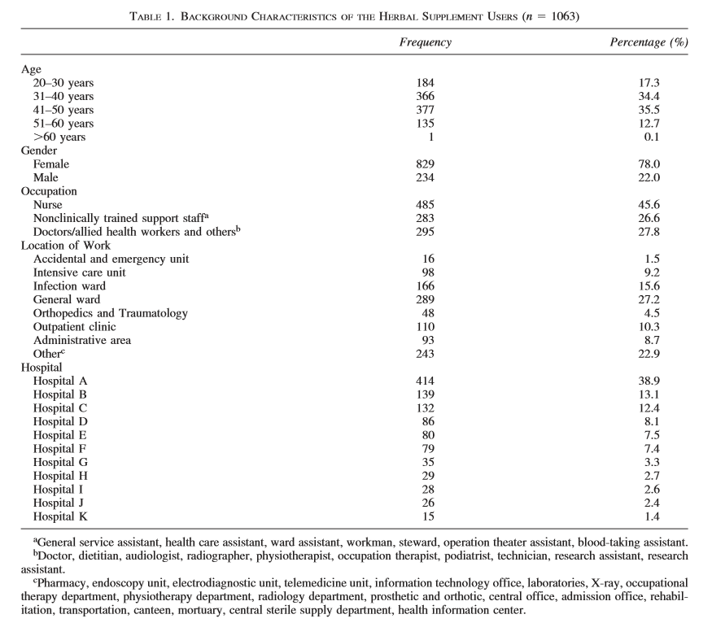

Slide 124
Prevention of SARS
Huang Qi 黃耆(Radix Astragali)
Bai Zhu 白朮(Rhizoma Atractylodis Macrocephalae)
Fang Feng 防風 (Radix Saposhnikoviae)
Sang Ye 桑葉 (Folium Mori)
Ju Hua 菊花 (Flos Chrysanthemi)
Bo He 薄荷 (Herba Menthae)
Lian Qiao 連翹 (Fructus Forsythiae)
Jie Geng 桔梗 (Radix Platycodonis)
Ku Xing Ren 苦杏仁 (Semen Armeniacae Amarum)
Lu Gen 蘆根 (Rhizoma Phragmitis)
Gan Cao 甘草 (Radix et Rhizoma Glycyrrhizae)
Da Qing Ye 大青葉 (Folium Isatidis)
Huang Qin 黃芩 (Radix Scutellariae)
Lau J, Leung P, Wong E, Fong C, Cheng K, Zhang S, et al. The use of an herbal formula by hospital
care workers during the severe acute respiratory syndrome epidemic in Hong Kong to prevent severe
acute respiratory. J Alternat Complement Med 2005;11:49-55.

Slide 125
Prevention of SARS
Yu Ping Feng San (Jade Windscreen Powder)
Sang Ju Yin (Mulberry Leaf and Chrysanthemum Decoction)
Da Qing Ye (Folium Isatidis)
Huang Qin (Radix Scutellariae)
Take the herbal supplement daily for 2 weeks.
Lau J, Leung P, Wong E, Fong C, Cheng K, Zhang S, et al. The use of an herbal formula by hospital
care workers during the severe acute respiratory syndrome epidemic in Hong Kong to prevent severe
acute respiratory. J Alternat Complement Med 2005;11:49-55.

Slide 126
Prevention of SARS
Results:
  1,063 herb group; 0 infected (0%)
  15,374 in non-herb group; 64 infected (0.4%)
  P = 0.035
    Note: Among 1,063 who took herbs, 19 (1.8%) with minor side effects such as diarrhea, sore throat, dizziness and nausea
Luo, H, Tang Q, Shang, Y et al. Can Can Chinese Medicine Be Used for Prevention of Corona Virus
Disease 2019 (COVID-19) Chinesee Journal of Integrative Medicine.
Lau J, Leung P, Wong E, Fong C, Cheng K, Zhang S, et al. The use of an herbal formula by hospital
care workers during the severe acute respiratory syndrome epidemic in Hong Kong to prevent severe
acute respiratory. J Alternat Complement Med 2005;11:49-55.

Slide 127
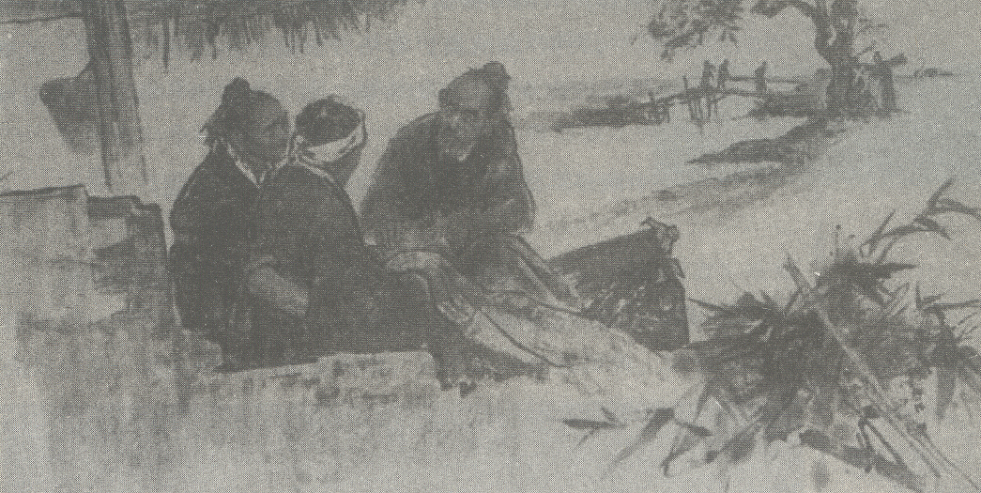
吴有性 Wū Yŏu-Xìng, 1580’s-1660’s

Slide 128
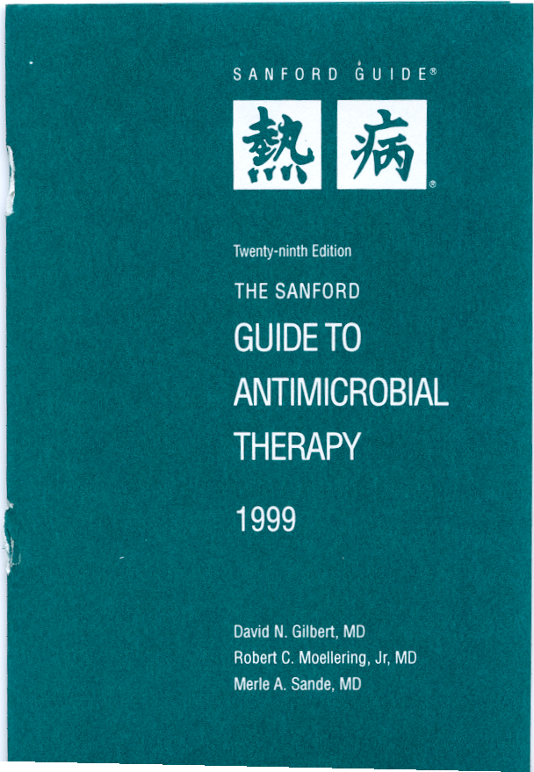

Slide 129
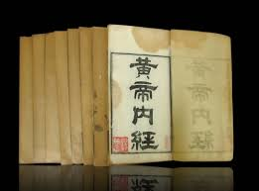
Rè Bìng 熱病(Hot Diseases)
Huang Di Nei Jing
(Yellow Emperor’s Inner Classic),
1st or 2nd Century A.D.

Slide 130
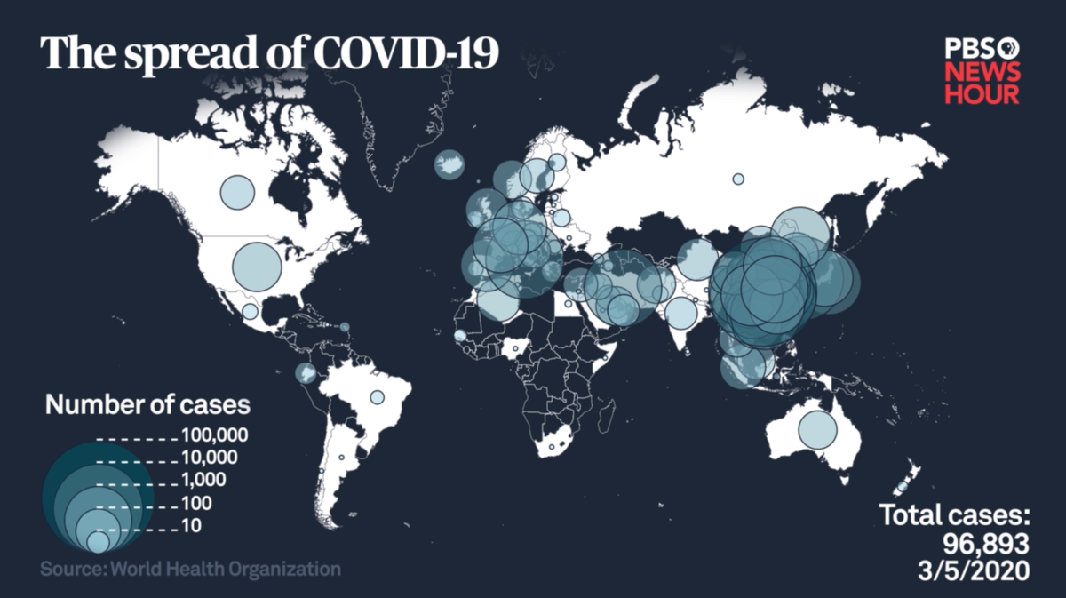
Where Do We Go From Here?

Slide 131
References (WHO, NIH, CDC, FDA)
Organization | Link
WHO | https://www.who.int/emergencies/diseases/novel-coronavirus-2019
NIH | https://www.nih.gov/health-information/coronavirus
CDC | https://www.cdc.gov/coronavirus/2019-ncov/about/index.html
FDA | https://www.fda.gov/emergency-preparedness-and-response/mcm-issues/novel-coronavirus-2019-ncov

Slide 132
References (WM)
Organization | Link
Elsevier | https://www.elsevier.com/connect/coronavirus-information-center
Johns Hopkins University | https://coronavirus.jhu.edu/
New England Journal of Medicine | https://www.nejm.org/doi/full/10.1056/NEJMoa2001017
JAMA | https://jamanetwork.com/journals/jama/pages/coronavirus-alert
The Lancet | https://www.thelancet.com/journals/lancet/article/PIIS0140-6736(20)30305-6/fulltext
Internet Book of Critical Care | https://emcrit.org/ibcc/covid19/?fbclid=IwAR31Xy-vkhL39xSWNAqkx3fECRR2yQLVbyWD2EOOoDG7FYv2WXqdQm7Lu_U#biology

Slide 133
References (TCM)
Organization | Link
Lotus Institute | https://www.elotus.org/articles
Guidance of Covid-19 English Edition | https://mp.weixin.qq.com/s/nOAmosQ4YqkXHKdJbBE9GA
Guidance of Covid-19 7th Edition (Chinese) | https://mp.weixin.qq.com/s/4Uzpwe2jNVMGiYi8hbQu9w
Guidance of Covid-19 7th Edition (English) | http://www.kankyokansen.org/uploads/uploads/files/jsipc/protocol_V7.pdf
Acupuncture in the Treatment of COVID-19 | https://www.journalofchinesemedicine.com/acupuncture-in-the-treatment-of-covid-19-an-exploratory-study.html?fbclid=IwAR2dUlmkqaEHnjjP5-jcJepRq6G2R8BkSWnTE510-axx57HJdRaszd1pgJQ

Slide 134
Reference
John K. Chen, Ph.D., Pharm.D., O.M.D., L.Ac.
drjohnchen@gmail.com

Slide 135
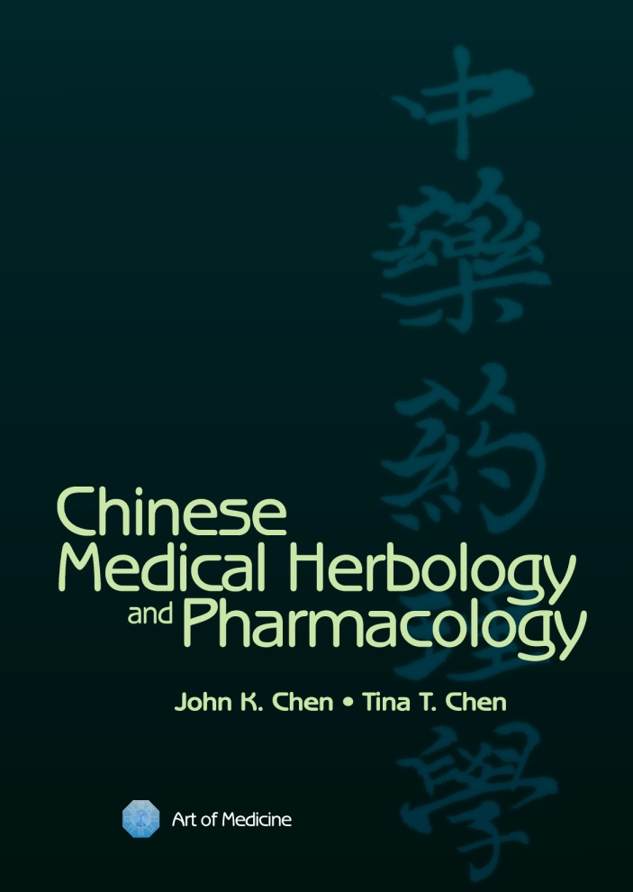
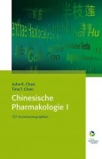
Single/Individual Herbs

Slide 136
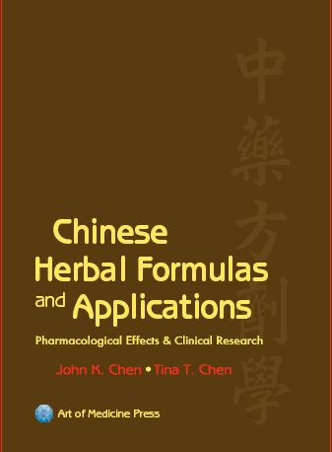
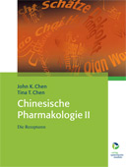
Herbal Formulas

